Slide 1


Osher Lifelong Learning Institute, Winter 2026
The Economics of Public Policy Issues
Johns Hopkins University
April 1, 2026
Robert Rebelein, Ph.D.
Associate Professor of Economics
Vassar College

Slide 2
Course Schedule
Contemporary Economic Policy Issues
  Week 1 (2/25): Economic Update & Tariffs Geoffrey Woglom, Amherst College
  Week 2 (3/04): An Introduction to Cryptocurrencies, Geoffrey Woglom
  Week 3 (3/11): Saving Social Security, Geoffrey Woglom
  Week 4 (3/18) Economics of Immigration, Robert Gitter, Ohio Wesleyan University
  Week 5 (3/25): Climate Change Economics, Sarah Jacobson, Williams College
  Week 6 (4/1): Health Care Economics, Robert Rebelein, Vassar College

Slide 3
Submitting Questions
Submit questions in the chat or by raising your digital hand.
  I will try to handle them as they come up.
We will do a verbal Q&A after the material has been presented.
Slides will be available on the NEED website tomorrow (https://needelegation.org/delivered_presentations.php)

Slide 4
Major Problems in the US
Expenditure growth is unsustainable
ACCESS to healthcare is not always great
QUALITY of healthcare is not always great
Increasing dependence on government payments
Lack of competition in key markets

Slide 5
Healthcare expenditures in the U.S.

Slide 6
Health Economics is Big Business
Healthcare is the biggest industry and the largest employer in the U.S.
We spend A LOT on healthcare:
  In 2024, U.S. national health expenditures were about $5.3 trillion -- approximately 18.0% of GDP ($15,000 per person)
  Expenditures grew 7.2% from 2023 to 2024
Notes:
Expenditures grew about 7.5% from 2022 to 2023.
Hopefully the comparison of the US health care industry to the entire economy of Germany, UK, and France will make students also appreciate how difficult any type of a reform is – when the sector being reformed is of this size and complexity.
https://databankfiles.worldbank.org/public/ddpext_download/GDP.pdf

Slide 7
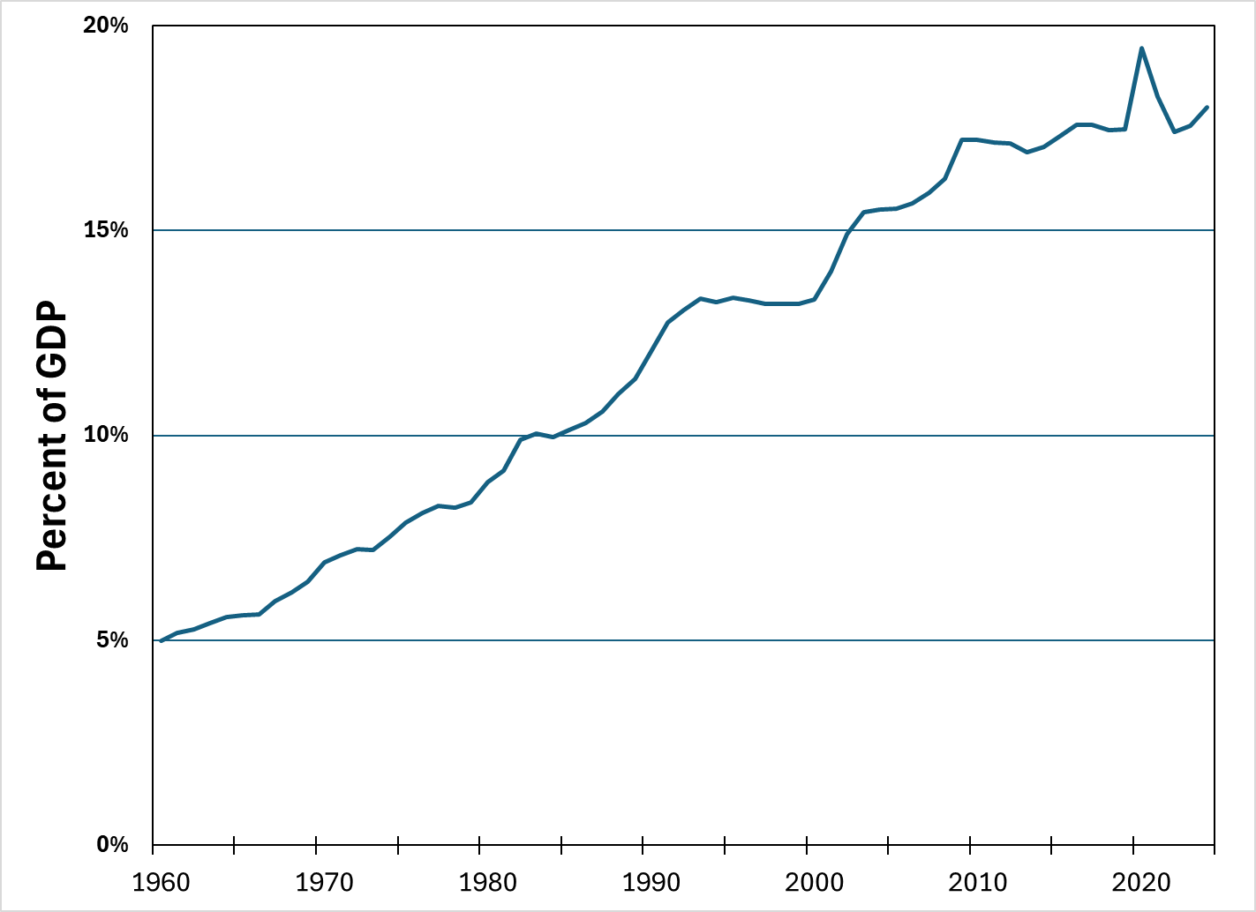
National Health Expenditure as Percent of GDP
19.5%
13%
9%
5%
Source: Centers for Medicare and Medicaid Services (graph by NEED)

Slide 8
Health Care Spending as % of GDP, 1980–2018
Everybody Else
Source: Roosa Tikkanen and Melinda K. Abrams, U.S. Health Care from a Global Perspective, 2019: Higher Spending, Worse Outcomes (Commonwealth Fund, Jan. 2020).

Slide 10
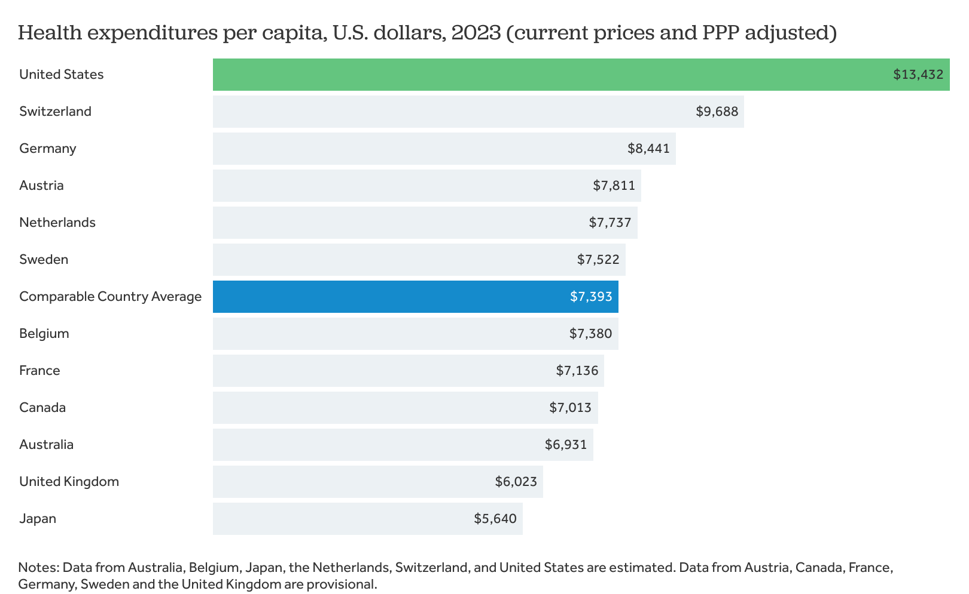
International Per Capita Healthcare Spending
US spends almost twice the comparable country average
Source: Peterson-KFF Health System Tracker
Notes:
https://www.healthsystemtracker.org/chart-collection/health-spending-u-s-compare-countries/#GDP%20per%20capita%20and%20health%20consumption%20spending%20per%20capita,%20U.S.%20dollars,%202023%20(current%20prices%20and%20PPP%20adjusted)%C2%A0
https://www.commonwealthfund.org/publications/issue-briefs/2020/jan/us-health-care-global-perspective-2019
A bit older report: https://www.commonwealthfund.org/publications/issue-briefs/2015/oct/us-health-care-global-perspective
https://www.healthsystemtracker.org/chart-collection/quality-u-s-healthcare-system-compare-countries/#item-overall-age-specific-potential-years-of-life-lost-per-100000-population-1990-2017
https://axenehp.com/international-healthcare-systems-us-versus-world/

Slide 12
Government Healthcare Spending Share (2023)
Source: Health at a Glance 2025 (OECD); graph by NEED
Notes:
Some good resources:
https://www.commonwealthfund.org/publications/issue-briefs/2020/jan/us-health-care-global-perspective-2019
A bit older report: https://www.commonwealthfund.org/publications/issue-briefs/2015/oct/us-health-care-global-perspective
https://www.healthsystemtracker.org/chart-collection/quality-u-s-healthcare-system-compare-countries/#item-overall-age-specific-potential-years-of-life-lost-per-100000-population-1990-2017
https://axenehp.com/international-healthcare-systems-us-versus-world/

Slide 13
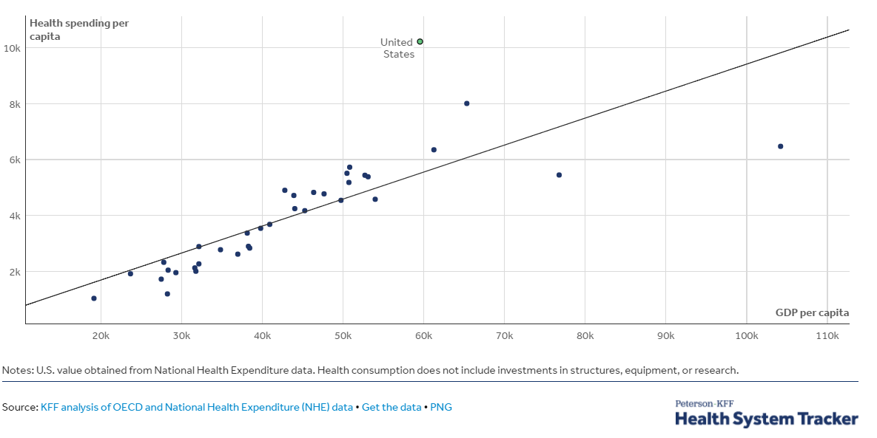
GDP per Capita and Health Spending per Capita, 2017

Slide 14
Health Care vs Social Services Spending
Source: E. H. Bradley and L. A. Taylor, The American Health Care Paradox: Why Spending More Is Getting Us Less, Public Affairs, 2013.
Notes:
From 2000 to 2011, for every dollar the US spent on health care, the country spent another $1.00 on social services, whereas across the OECD, for every dollar spent on health care, countries spend an additional $2.50 on social services

Slide 15
Health Care vs Social Care Spending
A 2013 study by Bradley and Taylor found that the U.S. spent the least on social services—such as retirement and disability benefits, employment programs, and supportive housing—among the countries studied in this report, at just 9 percent of GDP.
From 2000 to 2011, for every dollar the US spent on health care, the country spent another $1.00 on social services, whereas across the OECD, for every dollar spent on health care, countries spend an additional $2.50 on social services
Notes:
The U.S. invests the smallest share of its economy on social services.
A 2013 study by Bradley and Taylor found that the U.S. spent the least on social services—such as retirement and disability benefits, employment programs, and supportive housing—among the countries studied in this report, at just 9 percent of GDP.¹² Canada, Australia and New Zealand had similarly low rates of spending, while France, Sweden, Switzerland, and Germany devoted roughly twice as large a share of their economy to social services as did the U.S.
The U.S. was also the only country studied where health care spending accounted for a greater share of GDP than social services spending. In aggregate, U.S. health and social services spending rank near the middle of the pack.

Slide 16
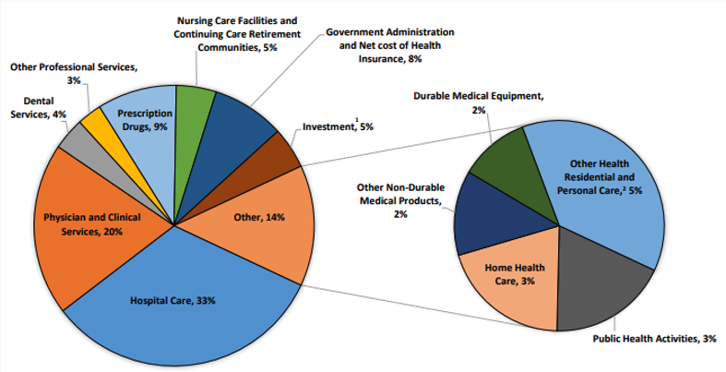
Where the money goes:
Source: Centers for Medicare & Medicaid Services, Office of the Actuary, National Health Statistics Group (2023).

Slide 17
U.S. Healthcare Expenditure Sources
 | Total ($bill) | Out-of-Pocket | Medicare | Medicaid | Private & other Health Ins. | Other Third-Party Payers | GDP ($bill) | Total Expends as a share of GDP | Medicare & Medicaid share of Federal Budget
1960 | $27 | 48% | 0% | 0% | 27% | 25% | $543 | 5% | 0%
1980 | $255 | 23% | 15% | 10% | 31% | 22% | $2,863 | 9% | 8%
2000 | $1,369 | 15% | 16% | 15% | 36% | 19% | $10,285 | 13% | 19%
2023 | $4,866 | 10% | 21% | 18% | 30% | 21% | $27,800 | 17.6% | 28%
Notes:
In 2024, 28% of federal noninterest spending went for healthcare
CBO projects that, in 2054, healthcare will consume 39% of federal noninterest spending

Slide 18
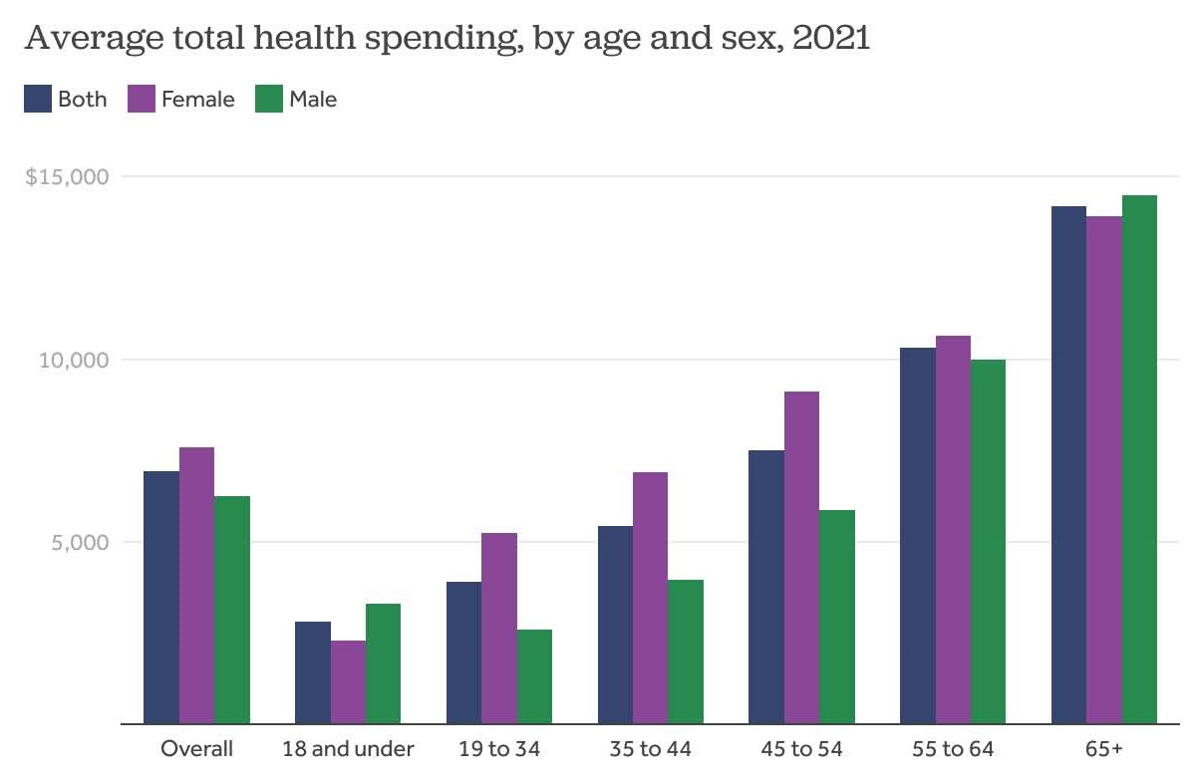

Slide 19
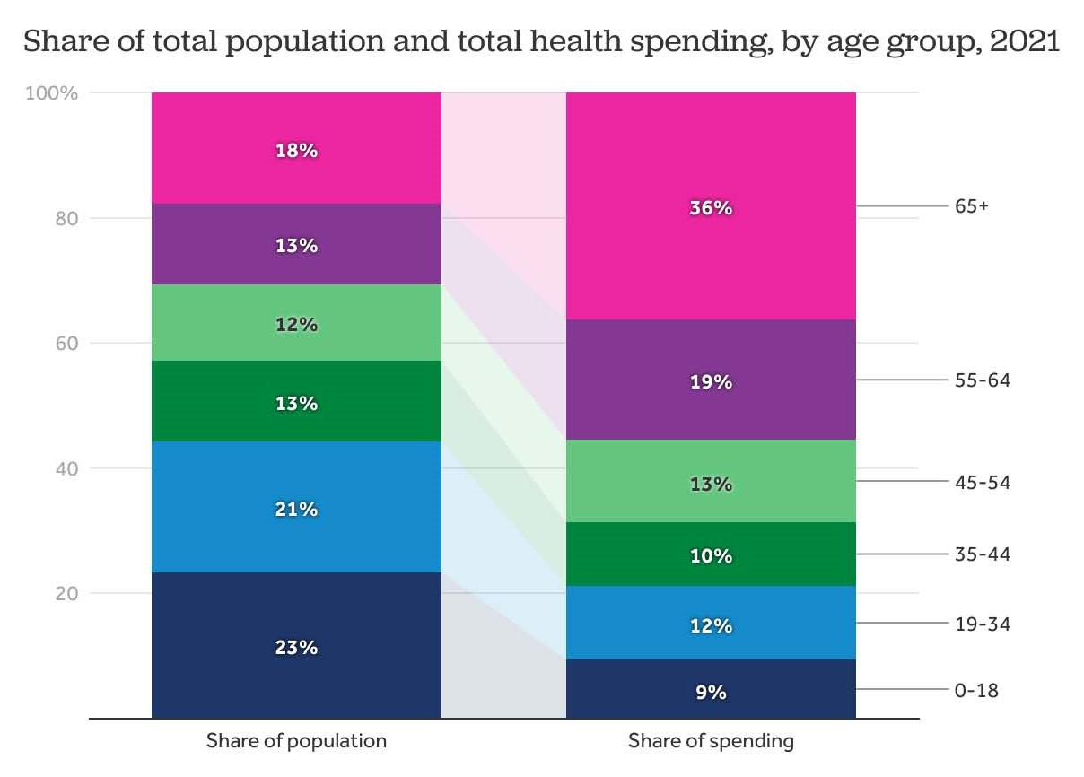

Slide 20
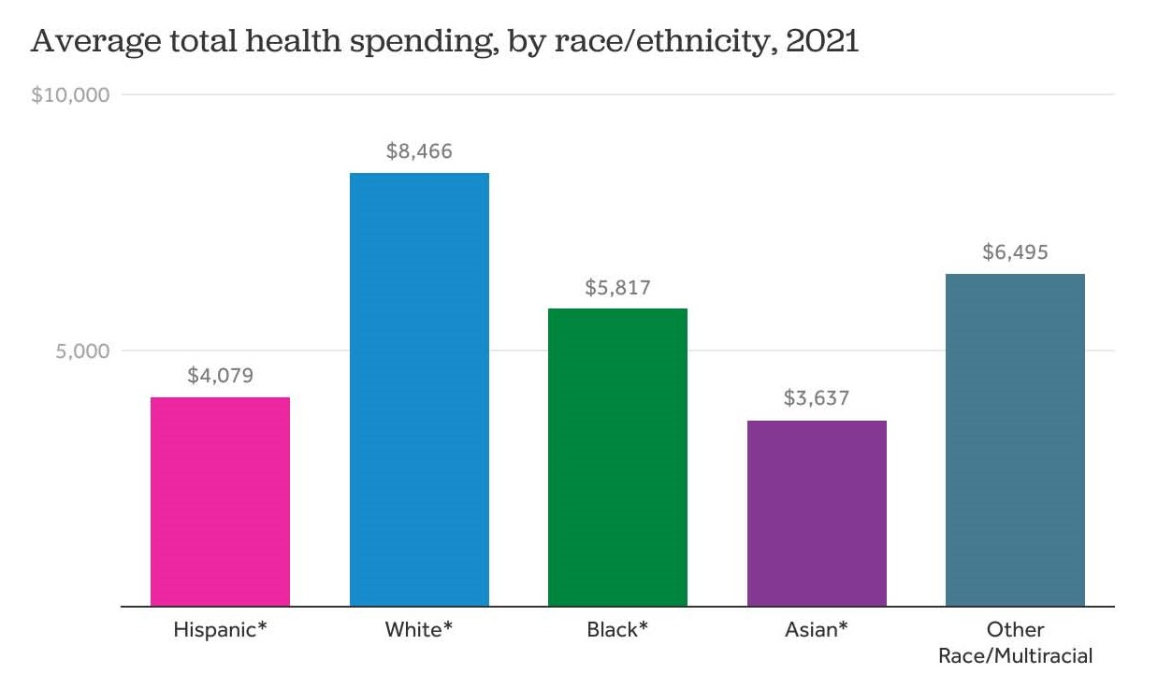

Slide 21
Inflation – CPI for all goods
Consumer Price Index

Slide 22
Inflation – CPI for Medical Care
Consumer Price Index for Medical Care
Consumer Price Index

Slide 23
Assessing the U.S. Healthcare System:
Access to Healthcare Services

Slide 24
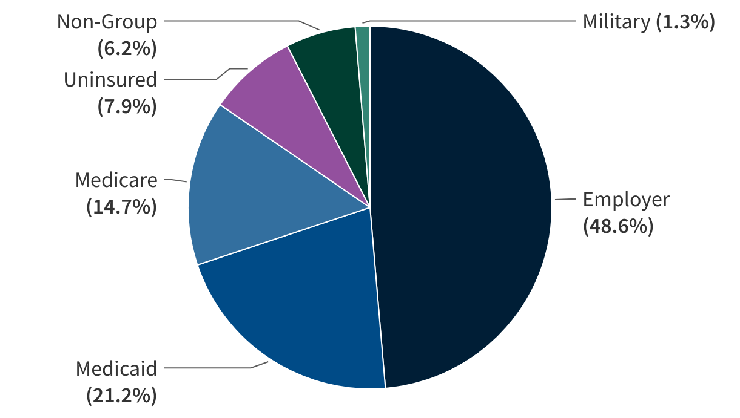
Health Insurance Coverage, 2023 – 92.1%
Source: KFF graph using 2023 American Community Survey
Notes:
7.9% of 340 million people is 27 million without health insurance

Slide 25
Health Insurance Coverage, 2022 – 92.1%
Countries with Less Than Universal Coverage
Countries with Universal Coverage
Country | % of Persons
Slovakia | 94.5
Chile | 94.3
UNITED STATES | 92.1
Poland | 91.5
Mexico | 90.2
Algeria | 90.9
Jordan | 55.0
Countries | % of Persons
Australia | 100
Canada | 100
Czech Republic | 100
France | 100
United Kingdom | 100
Greece | 100
Hungary | 100
And 21 more | 99+
Source: Organization for Economic Cooperation and Development
Notes:
7.9% of 340 million people is 27 million without health insurance

Slide 26
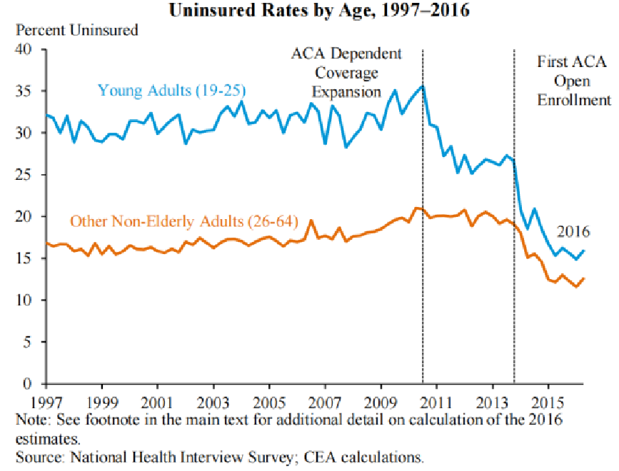
Uninsured Rate dropped dramatically with the ACA; Drop was more significant for young adults
Notes:
Source: National Health Interview Survey; CEA calculations

Slide 27
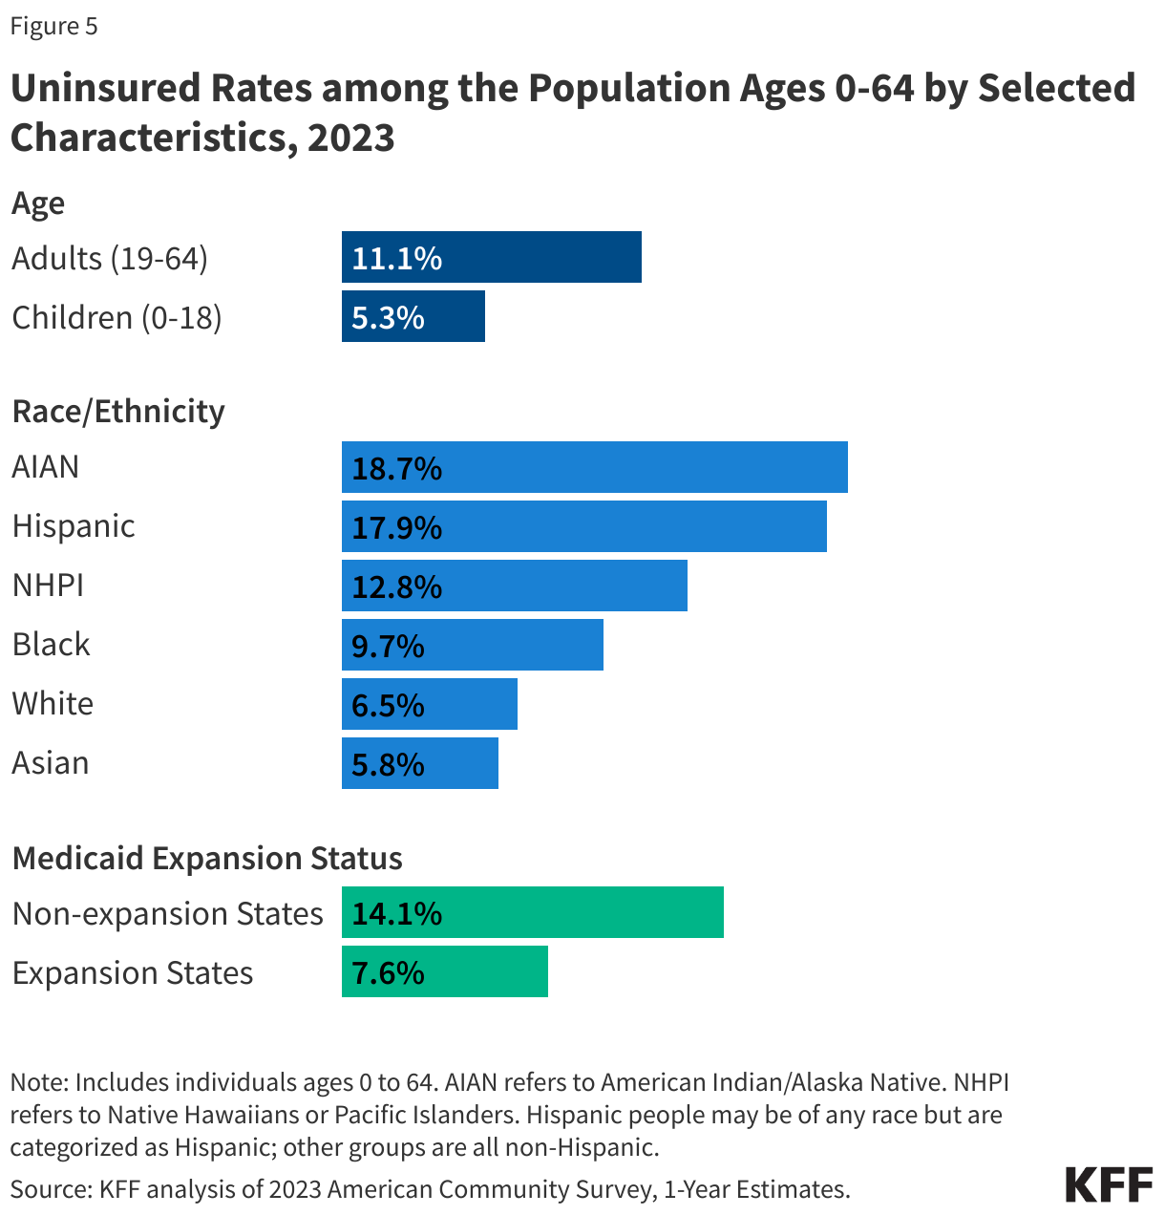
America’s Uninsured
Source: KFF graph using 2023 American Community Survey

Slide 28
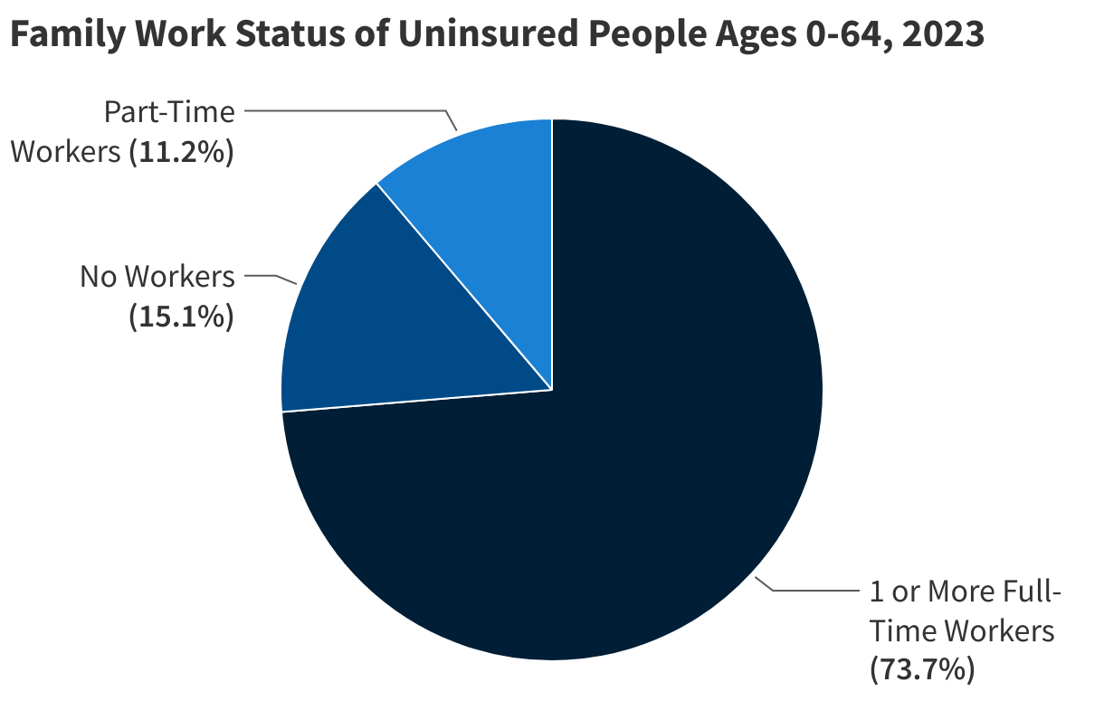
America’s Uninsured
Note: includes individuals age 0-64
Source: KFF graph using 2023 American Community Survey

Slide 29
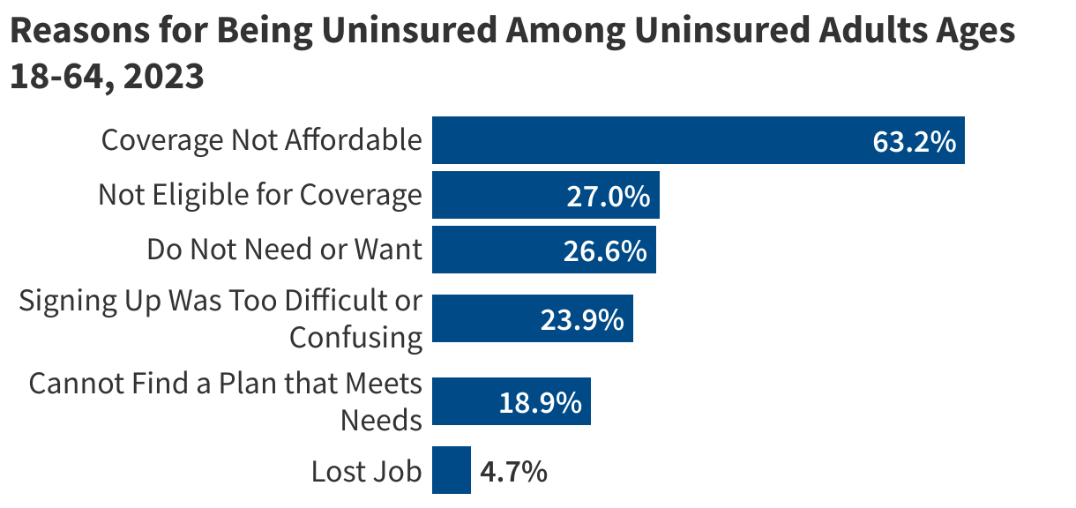
America’s Uninsured
Source: KFF graph using data from the 2023 National Health Interview Survey

Slide 30
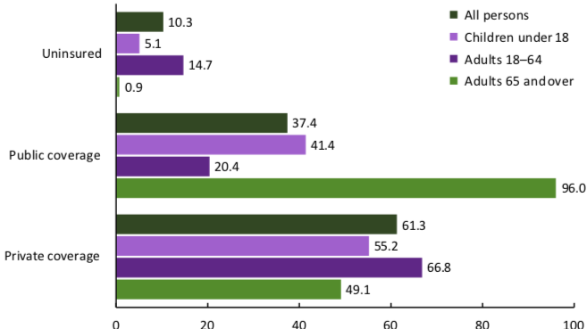
Health Insurance Coverage By Age, 2019
Percent of Persons
Source: National Center for Health Statistics
Notes:
Percentages may add to more than 100% because some people are covered by multiple programs

Slide 31
Health Insurance Coverage by Income, 2023
Source: NEED graph using data accessed via SHADAC from the American Community Survey

Slide 32
Insurance Non-Coverage by Race/Ethnicity, 2023
AIAN refers to American Indian/Alaska Native; NHPI refers to Native Hawaiians or Pacific Islanders
Source: KFF graph using 2023 American Community Survey

Slide 33
Physician Supply
Source: https://worldpopulationreview.com/country-rankings/doctors-per-capita-by-country

Slide 34
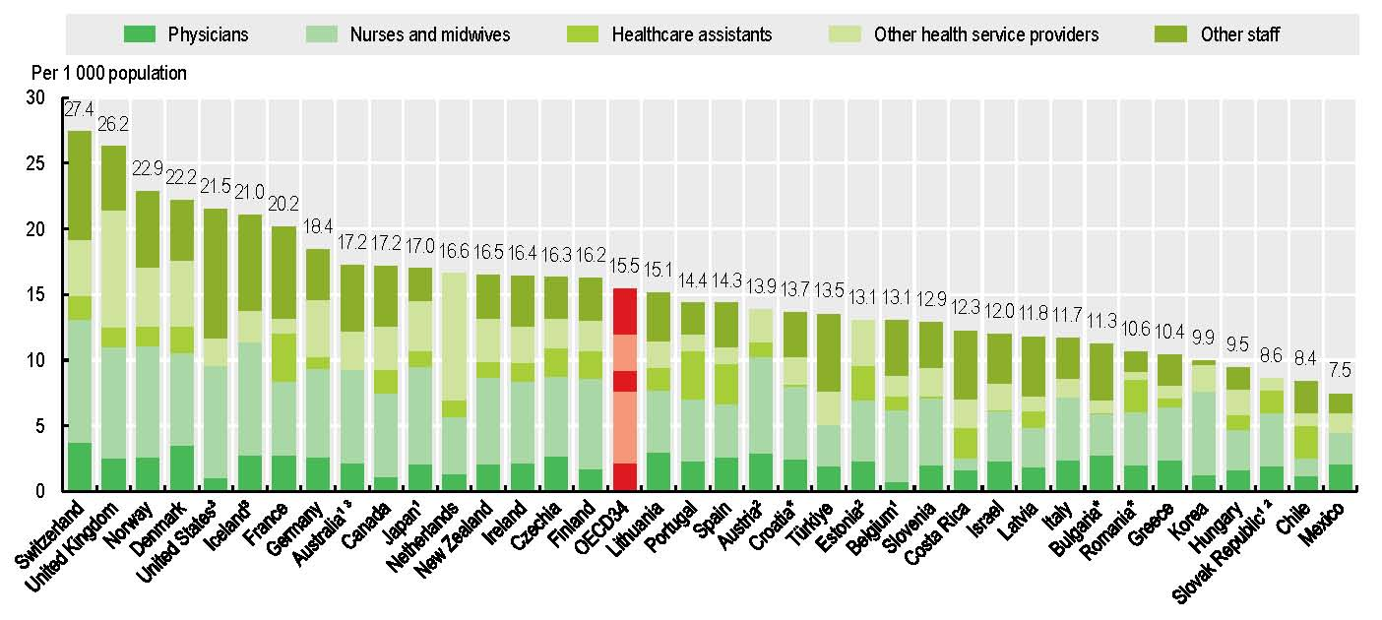
Hospital Staff per 1,000 population (2023)
U.S.
Source: Health at a Glance, 2025 OECD
Notes:
Note that the U.S. has the largest share of non-clinical staff (46% of staff). These include administrative positions, cleaning staff, security, IT, and others. Removing non-clinical staff from the data would put the U.S. below the OECD average for clinical staff.

Slide 35
Physician Visits per capita (2023)
Source: Health at a Glance, 2025 OECD

Slide 36
Percent of Women Ages 18–64 Who Reported
Having A Regular Doctor/Regular Place of Care
Source: Commonwealth Fund 2023 International Health Policy Survey
Notes:
Source: Munira Z. Gunja, Relebohile Masitha, and Laurie C. Zephyrin, Health Care for Women: How the U.S. Compares Internationally (Commonwealth Fund, Aug. 2024). https://doi.org/10.26099/7322-n764

Slide 37
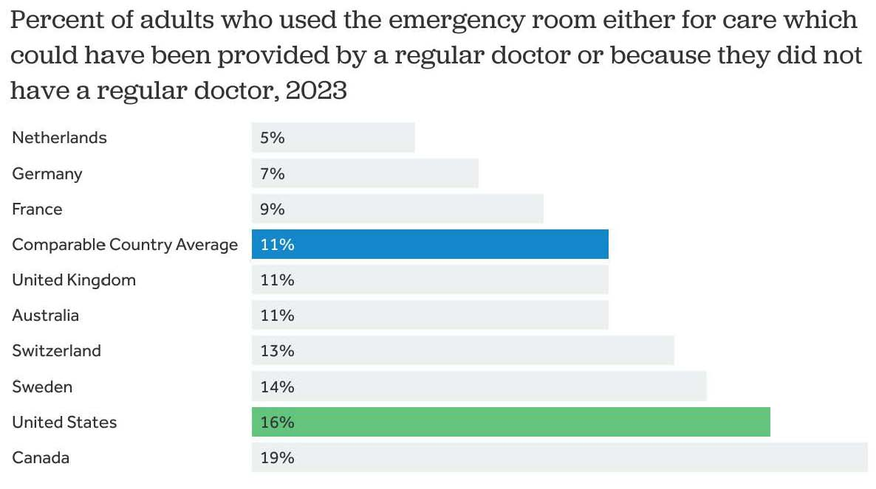
Percent of Women Ages 18–64 Who Reported Going to the Emergency Room in the Past Two Years
Source: KFF, using data from Commonwealth Fund International Health Policy Survey (2023)

Slide 38
Hospital Acute Care Average Length of Stay
Average length of stay for acute care (days)

Slide 39
Hospital Beds per 1,000 People (2023)
Source: Health at a Glance, 2025, OECD (graph by NEED)

Slide 40
Acute Care Hospital Beds per 100,000 People (2025)
Source: World Population Review; graph by NEED
Notes:
https://worldpopulationreview.com/country-rankings/icu-beds-per-capita-by-country

Slide 41
Waited Less Than a Month to See A Specialist
But how much time did they spend
with the specialist?
How often was it necessary to see a specialist?
Percent of Women Ages 18-64
Source: 2011 Commonwealth Fund International Health Policy Survey of Sicker Adults in Eleven Countries.

Slide 42
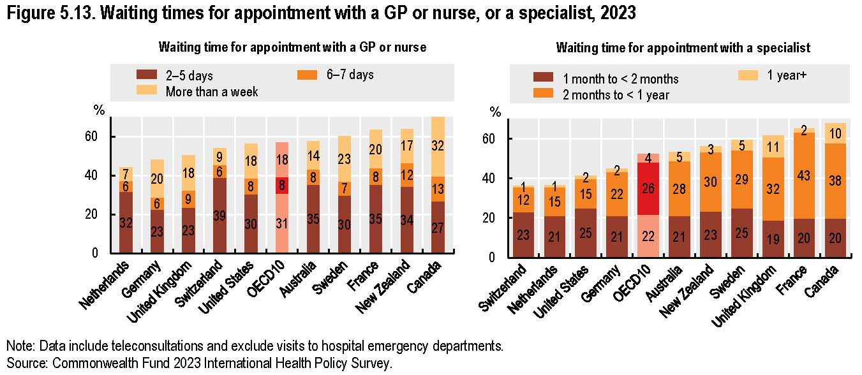
Source: Health at a Glance, 2025 OECD

Slide 43
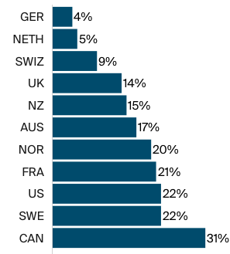
More About Wait Times
Percentage of adults aged 65+
who waited more than 6 days
for an appointment when sick.
U.S.
Source: Commonwealth Fund, Comparing Nations on Timeliness and Coordination of Health Care, 2021

Slide 44
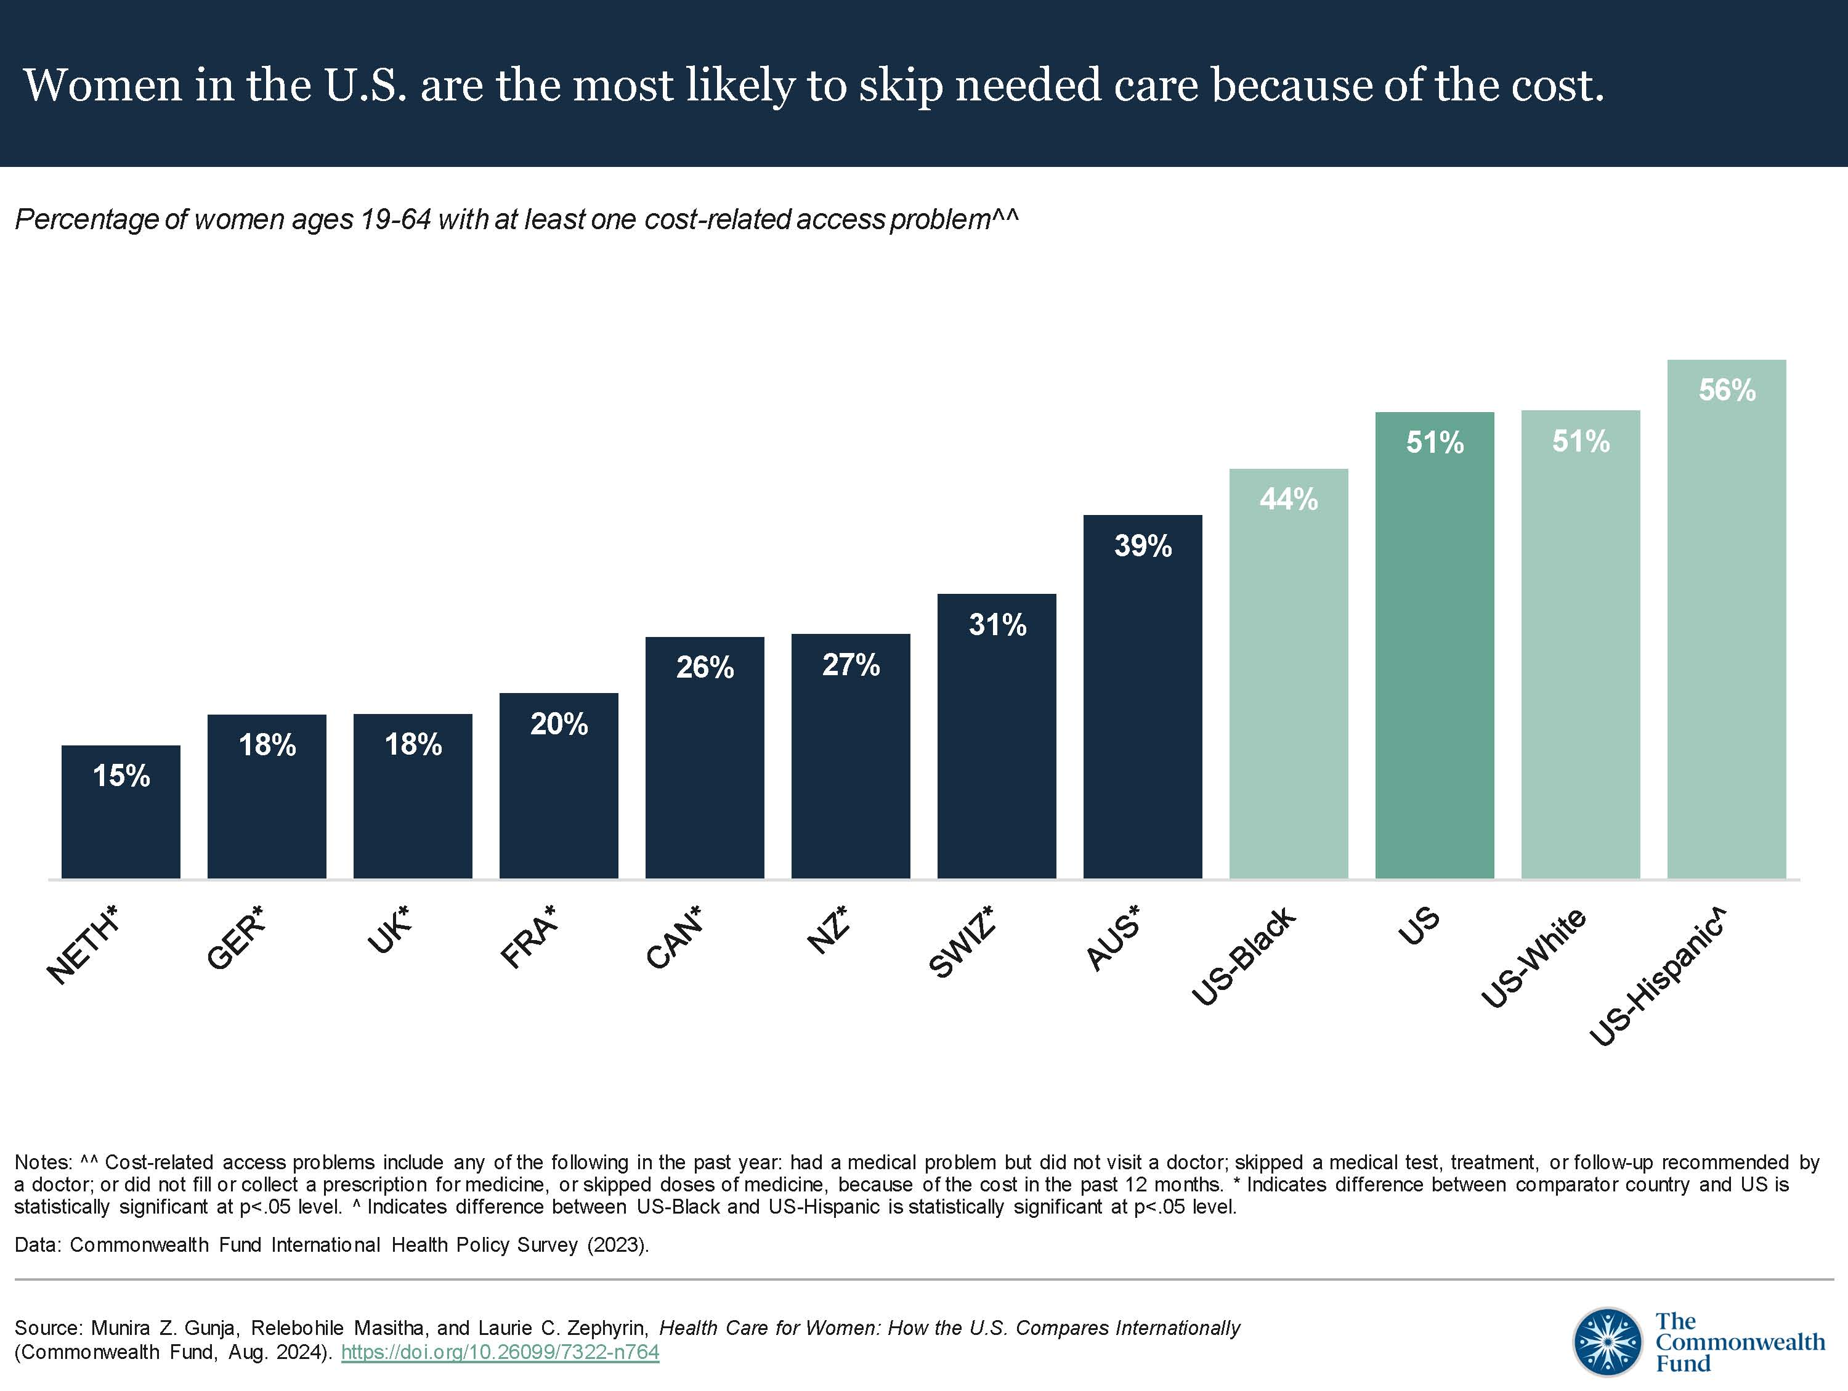
Skipped Care Because of Cost (2022)
Percent of women ages 18–64 with at least one
cost-related access problem
Source: Munira Z. Gunja, Relebohile Masitha, and Laurie C. Zephyrin, Health Care for Women: How the U.S. Compares Internationally (Commonwealth Fund, Aug. 2024).
Notes:
Source: Munira Z. Gunja, Relebohile Masitha, and Laurie C. Zephyrin, Health Care for Women: How the U.S. Compares Internationally (Commonwealth Fund, Aug. 2024).

Slide 45
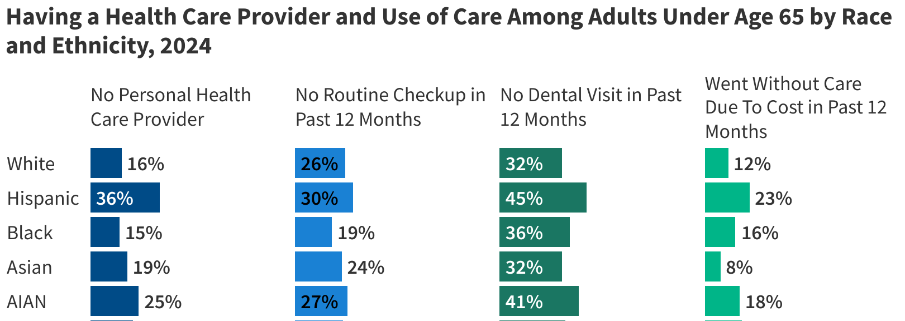
Having a regular care provider
Source: KFF analysis of 2024 Behavioral Risk Factor Surveillance Survey

Slide 46
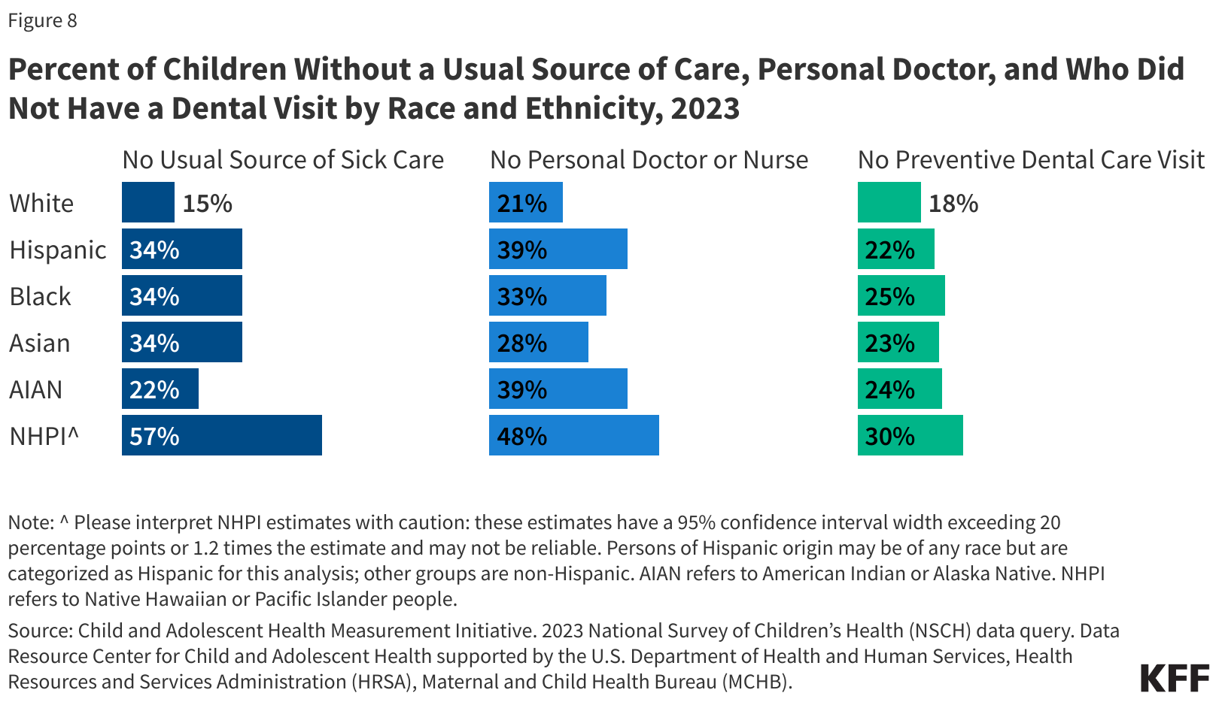
Children’s access to Health Care
Source: KFF analysis of data from NSCH, HRSA, and MCHB
Notes:
Source: Child and Adolescent Health Measurement Initiative. 2023 National Survey of Children’s Health (NSCH) data query. Data Resource Center for Child and Adolescent Health supported by the U.S. Department of Health and Human Services, Health Resources and Services Administration (HRSA), Maternal and Child Health Bureau (MCHB).

Slide 47
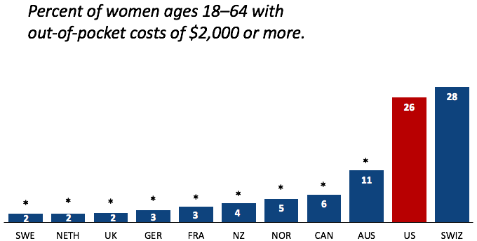
Out-of-Pocket Costs
Source: Munira Z. Gunja et al., What Is the Status of Women’s Health and Health Care in the U.S. Compared to Ten Other Countries? (Commonwealth Fund, Dec. 2018).

Slide 48
Medical Bill Problems
Percent of women ages 18–64 with at least one medical bill problem.
*
*
*
*
*
*
*
*
*
*
Source: Munira Z. Gunja et al., What Is the Status of Women’s Health and Health Care in the U.S. Compared to Ten Other Countries? (Commonwealth Fund, Dec. 2018).
Notes:
Notes: ^ Medical bill problems include any of the following in the past year: 1) serious problems paying or were unable to pay medical bills; 2) spent a lot of time on paperwork or disputes related to medical bills; or 3) insurance denied payment or paid less than expected. * Statistically significant difference compared to the United States (p<.05).
Data: The Commonwealth Fund International Health Policy Survey, 2016.
Source: Munira Z. Gunja et al., What Is the Status of Women’s Health and Health Care in the U.S. Compared to Ten Other Countries? (Commonwealth Fund, Dec. 2018). https://doi.org/10.26099/wy8a-7w13

Slide 49
Avoidable Deaths
Deaths per 100,000 population.
Heart disease, stroke, diabetes…
Source: Roosa Tikkanen and Melinda K. Abrams, U.S. Health Care from a Global Perspective, 2019: Higher Spending, Worse Outcomes (Commonwealth Fund, Jan. 2020).

Slide 50
Notes about Healthcare Access
Insurance coverage in the U.S. is not universal.
  Is universal in most other developed countries.
Wait times are not necessarily lower in the U.S.
Supply of medical personnel and equipment is lower than some comparable countries
Emergency room use is higher in the U.S. than elsewhere.
Specialized medicine more accessible in the U.S.
The U.S. has fewer physicians and fewer physician visits than most peer countries

Slide 51
Assessing the U.S. Healthcare System:
Quality of Healthcare Services

Slide 52
Life Expectancy: How Does the US Compare?
United States
Source: KFF data collection. https://www.healthsystemtracker.org/chart-collection/quality-u-s-healthcare-system-compare-countries/
Notes:
Among the 34 countries in the OECD, the US in 2010 was 27th in life expectancy at birth

Slide 53
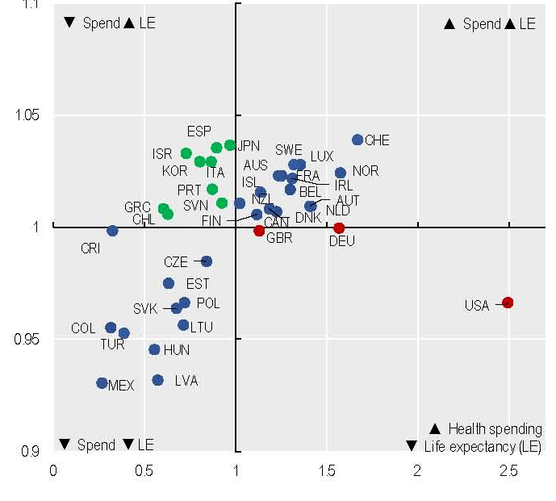
Health Expenditure vs. Life Expectancy (2023)
Relative Life Expectancy
US has highest spending per capita and below average life expectancy
Source: Health at a Glance, 2025 OECD

Slide 54
Life Expectancy at Birth by Race/Ethnicity, 2019
Race/Ethnicity | Life Expectancy (Years)
All Races | 78.8
White | 78.8
Black | 74.8
Hispanic | 81.9
Asian | 85.6
Source: KFF, Key Data on Health and Health Care by Race and Ethnicity
Notes:
CDC

Slide 55
Income Also Matters – Reflecting Access?
Sex | Income Category | Life Expectancy (Years) | Difference High vs Low
Women | Highest Incomes (top 1%) | 88.9 | 10.1 years
 | Lowest Incomes (bottom 1%) | 78.8
Men | Highest Incomes (top 1%) | 87.3 | 14.6 years
 | Lowest Incomes (bottom 1%) | 72.7
Sex | Income Category | Life Expectancy Years | Difference High to Low
Women | Highest Incomes (top 1%) | 88.9 | 10.1 years
 | Lowest Incomes (bottom 1%) | 78.8
Men | Highest Incomes (top 1%) | 87.3 | 14.6 years
 | Lowest Incomes (bottom 1%) | 72.7
Source: https://healthinequality.org/documents/paper/healthineq_summary.pdf

Slide 56
Infant Mortality Comparison(2023)
Deaths per 1,000 live births
Source: Health at a Glance, 2025 OECD; graph by NEED

Slide 57
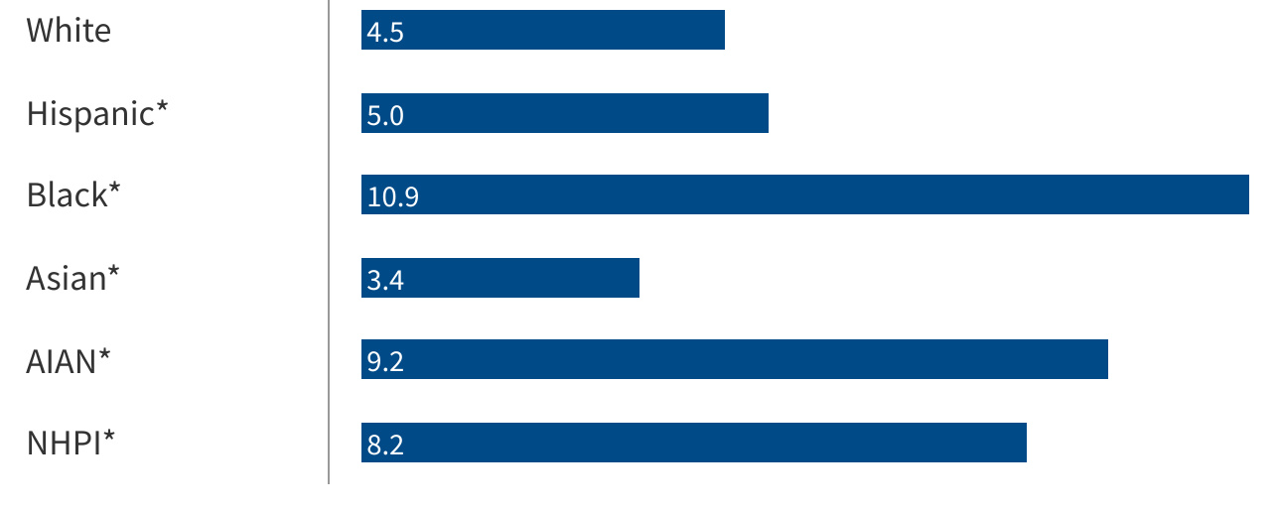
Infant Mortality by Race/Ethnicity (2023)
Deaths per 1,000 live births
Source: Ely, DM, Driscoll, AK. Infant mortality in the United States, 2023, CDC
Notes:
Source: Ely, DM, Driscoll, AK. Infant mortality in the United States, 2023: Data From the Period Linked Birth/Infant Death File. National Vital Statistics Report Vol. 74 No. 7, National Center for Health Statistics, Centers for Disease Control and Prevention, 2025.Get the dataDownload PNG
* Indicates the difference in values from those for Whites is statistically significant

Slide 58
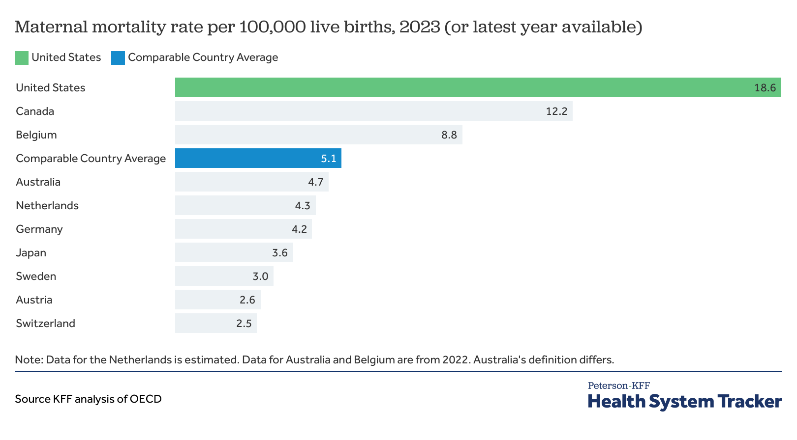
Maternal Mortality Rates per 100,000 live births (2023)
Source: KFF analysis of OECD data

Slide 59
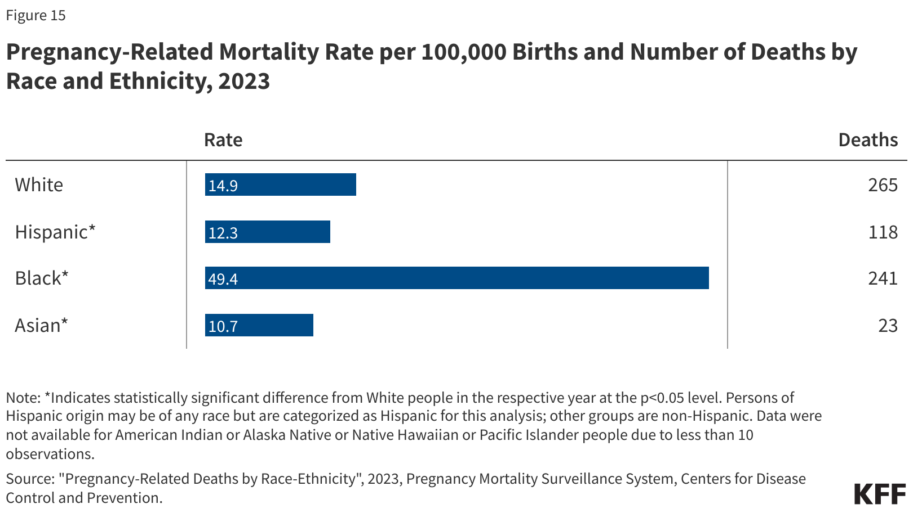
Maternal Mortality Rates by Race
Source: Pregnancy-Related Deaths by Race-Ethnicity, 2023, CDC

Slide 60
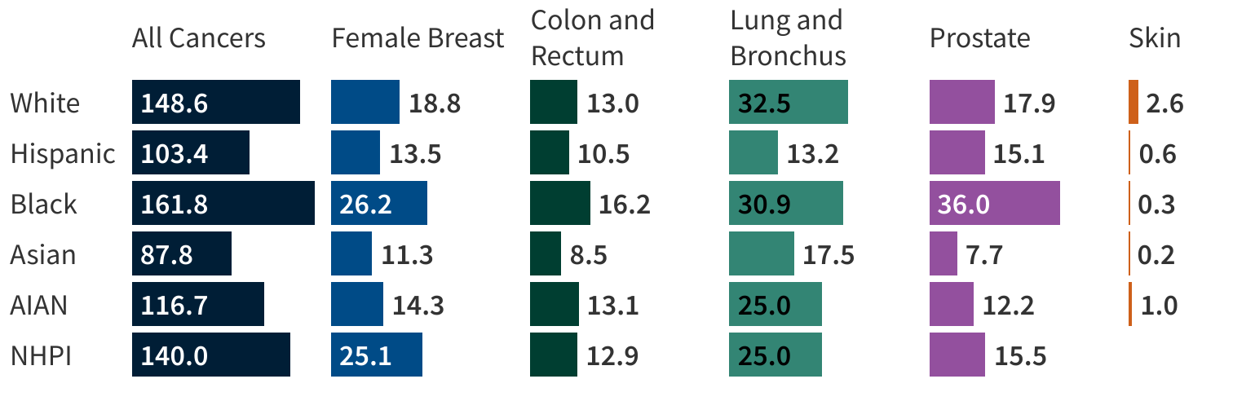
Age-Adjusted Rate of Cancer Mortality per 100,000 by Race and Ethnicity, 2023
Source: KFF analysis of CDC data
Notes:
Source: U.S. Cancer Statistics Working Group. U.S. Cancer Statistics Data Visualizations Tool, based on 2024 submission data (1999-2023): U.S. Department of Health and Human Services, Centers for Disease Control and Prevention and National Cancer Institute; https://www.cdc.gov/cancer/dataviz, released in June 2025.

Slide 61
Measles Immunization (2024)
Percentage of eligible children receiving two doses of measles vaccination
Source: Health at a Glance, 2025 OECD; graph by NEED

Slide 62
Flu Immunizations (2024)
Source: Health at a Glance, 2025 OECD; graph by NEED

Slide 63
Breast Cancer Screening (2023)
Source: Health at a Glance, 2025 OECD; graph by NEED

Slide 64
Colorectal Cancer Screening Coverage (2023)
Source: Health at a Glance, 2025 OECD; graph by NEED

Slide 65
Prevention and Screening
The U.S. excels in several prevention measures
  including vaccinations and cancer screenings.
Among OECD countries, the U.S. has
  The highest average five-year survival rate for breast cancer,
  but the lowest five-year survival rate for cervical cancer.

Slide 66
Percent of adults who have experienced medical, medication, or lab errors or delays
Source: 2016 Commonwealth Fund International Health Policy Survey.

Slide 67
Obesity Rates (2022)
Source: The World Population Review; graph by NEED
Notes:
https://worldpopulationreview.com/country-rankings/obesity-rates-by-country

Slide 68
Suicides per 100,000 people (2023)
Source: NEED graph using data from the World Population Review
Notes:
https://worldpopulationreview.com/country-rankings/suicide-rate-by-country

Slide 69
Cancer Mortality, Deaths per 100,000 (2023)
Source: Health at a Glance, 2025 OECD; graph by NEED

Slide 70
Hospital Admissions, Congestive Heart Failure
Source: Health at a Glance, 2025 OECD; graph by NEED

Slide 71
Hospital Admissions, Diabetes (2023)
Source: Health at a Glance, 2025 OECD; graph by NEED

Slide 72
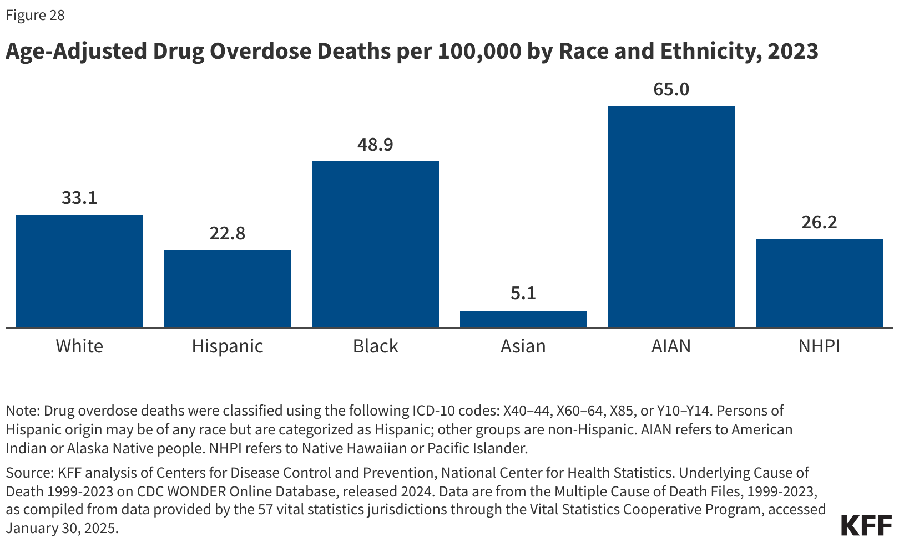
Drug Overdose Deaths per 100,000 (2023)
Source: KFF analysis of CDC data
Notes:
Source: KFF analysis of Centers for Disease Control and Prevention, National Center for Health Statistics. Underlying Cause of Death 1999-2023 on CDC WONDER Online Database, released 2024. Data are from the Multiple Cause of Death Files, 1999-2023, as compiled from data provided by the 57 vital statistics jurisdictions through the Vital Statistics Cooperative Program, accessed January 30, 2025

Slide 73
Adults with Multiple Chronic Conditions, 2016
Source: Roosa Tikkanen and Melinda K. Abrams, U.S. Health Care from a Global Perspective, 2019: Higher Spending, Worse Outcomes (Commonwealth Fund, Jan. 2020).

Slide 74
Notes About U.S. Healthcare Quality
The U.S. has the highest chronic disease burden
  and an obesity rate that is two times higher than the OECD average.
The U.S. has the highest rate of avoidable deaths and one of the highest rates of hospitalization for avoidable causes.
Americans use more expensive technologies and specialists
  MRIs, and specialized procedures, such as hip replacements, more often than our peers.
The U.S. outperforms its peers in terms of many preventive measures
Avoidable deaths are higher in U.S., perhaps indicating less access to care

Slide 75
The Economics of Healthcare

Slide 76
An Economic View
The Healthcare system consists of many markets:
  Medical services
  Physicians
  Nurses
  Other care providers
  Hospital facilities
  Pharmaceuticals
  Health Insurance
  Medical supplies (e.g., diagnostic and therapeutic equipment)
  Nursing homes
  Rehab facilities
  Other?
Notes:
Many participants, some with competing objectives

Slide 77
Medical Services Unlike Other Products
For most products, the price reflects the good’s value to buyers and the cost to sellers for producing the good; prices adjust to balance supply and demand.
  ➔Market prices guide economic decisions and help to allocate society’s scarce resources.
Third-party payment system separates buyers (and many sellers!) from the true cost of the products/services they are consuming
Many healthcare products/services are heterogeneous across consumers
  ➔Buyers are poorly informed and ask suppliers what they need

Slide 78
Health Care Markets are Different
Sponsor
(Gov’t or Employer)
Premiums
Insurer or
third-party payers
Premiums
Claims
Taxes or Lower Wages
Insurance Coverage
Payment
Services
Consumers
Producers
Price
Health Care Providers (hospitals, physicians)
Patients
Out-of-pocket fees

Slide 79
How much does an office visit cost to produce?
Any ideas? Includes cost of facility and supplies, wages for doctors and nurses and other staff, their utilities and insurance, etc. (Do the doctors know???)
We pay a small co-pay
One result is that we consume more healthcare than we would if we had to pay its full cost (moral hazard)

Slide 80
Rising HC Expenditures: Demand factors
Why the Rapid Rise in Costs?
Rising incomes
  health care is a “normal” good
Aging population
Unhealthy lifestyles
Over-indulgence in specialized care
  2 in 5 adults in the U.S. get general care from specialists
LO4
21-80
Notes:
Healthcare is a normal good with an income elasticity coefficient that is about 1 and a price elasticity of demand coefficient that is as low as .2. As the population ages, the demand for healthcare is likely to increase.

Slide 81
Rising HC Expenditures: Demand factors (cont.)
Why the Rapid Rise in Costs?
Role of providers:
  Supplier induced demand (?)
  Defensive medicine (?)
Third-party payer system separates consumers from the cost of services
  ➔Prices can’t properly signal surpluses or shortages, etc.
LO4
21-81
Notes:
Healthcare is a normal good with an income elasticity coefficient that is about 1 and a price elasticity of demand coefficient that is as low as .2. As the population ages, the demand for healthcare is likely to increase.

Slide 82
Rising HC Expenditures: Supply Factors
Limited supply of physicians
Changes in medical technology
  improved quality of tests, procedures, drugs, etc.
Slow productivity growth
Complex payment systems
High administrative costs & lack of price control
  Health care payers and providers spend $496 billion per year on billing/insurance costs
LO4
21-82
Notes:
The supply of physicians in the US has increased over the years; however, this supply has not kept up with the increase in the demand for physicians’ services. Health care is a service, and it is generally more difficult to increase productivity for a service than for goods. Some technological advances in the way we deliver healthcare have lowered costs; however, more often those medical technologies have been more expensive.

Slide 83
Two Comments
The United States has the only profit-motivated healthcare system in the world.
We have a health RESTORATION system, not a health CARE system.

Slide 84
Another Difference: “Right” or Moral Imperative
Health care as a product is often viewed as a “right” or moral imperative.
  This view argues for greater government interaction in the market, primarily to promote access.
    ➔Subsidies for insurance and care.
    ➔Market regulations to reduce inequities.
Unfettered free markets are unlikely to achieve social goals with respect to health care.

Slide 85
Consequences of Rising Expenditures
Reduced access to care
  Waiting for treatment increases costs
Slower wage growth
Personal bankruptcies
Impact on government budgets
LO2
21-85
Notes:
Rising health care costs cause employers to reduce, or eliminate, offering health insurance. The wages grow at a slower pace because health care costs make up a larger percentage of pay. Employers save money on health care if workers are part-time or temporary. Spending through Medicare and Medicaid is the fastest growing segment of the federal budget, and states can’t cover their share.

Slide 86
Tradeoffs
Tradeoffs take place among access, quality, and cost:
Increasing quality in health care may lead to higher health care costs.
  This could mean a compromise in access (affordability).
I.e., with increasing quality, access may suffer.
By increasing access, quality and cost may suffer.
By decreasing costs, quality may suffer.
In healthcare in the United States, there are potential opportunities to improve all three simultaneously.
E.g., it is possible that increasing quality can reduce costs.

Slide 87
Concentration in specific markets:
1) Pharmaceuticals

Slide 88
Spending on Pharmaceuticals (2023)
Source: Health at a Glance, 2025 OECD; graph by NEED
Notes:
https://en.wikipedia.org/wiki/Prescription_drug_prices_in_the_United_States
https://www.ft.com/content/e92dbf94-d9a2-11e9-8f9b-77216ebe1f17

Slide 89
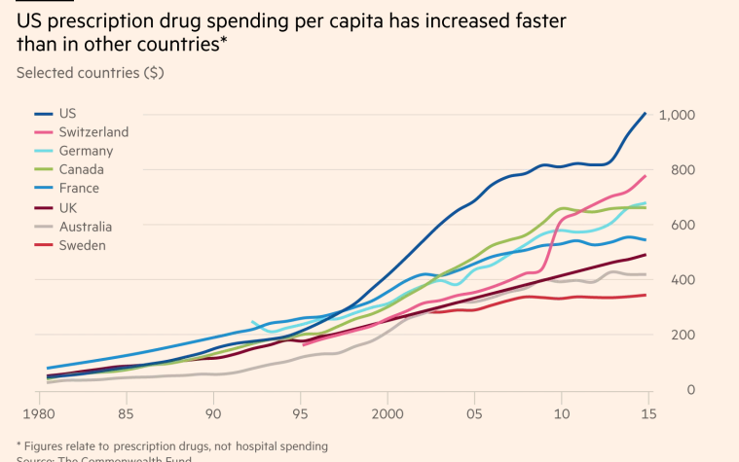
Spending on Pharma: Trends Over Time

Slide 90
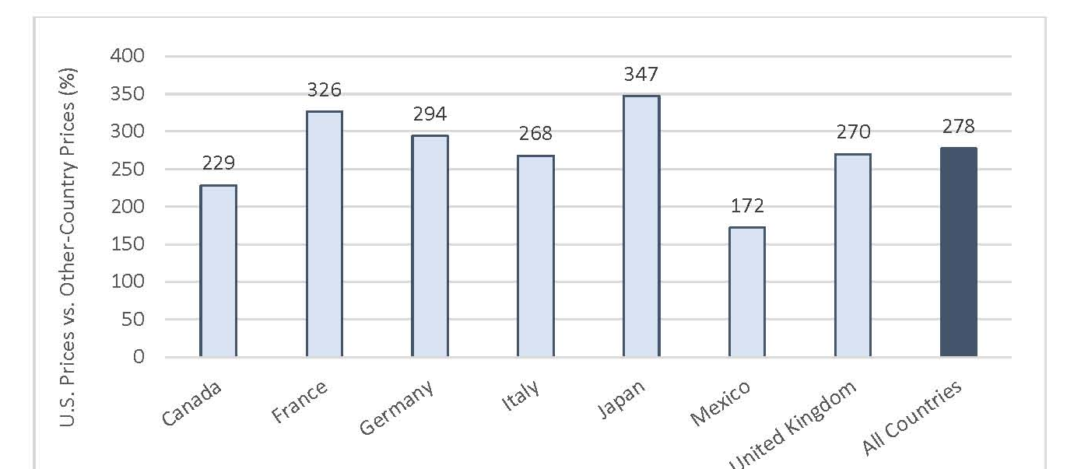
Comparing Prescription Drug Prices (2022)
U.S. Prescription Drug Prices as a Percentage of Prices in selected other (OECD) countries
Source: International Prescription Drug Price Comparisons, A.W. Mulcahy, D. Schwam, and S.L. Lovejoy, RAND, 2024
Notes:
All countries refers to the 33 OECD countries

Slide 91
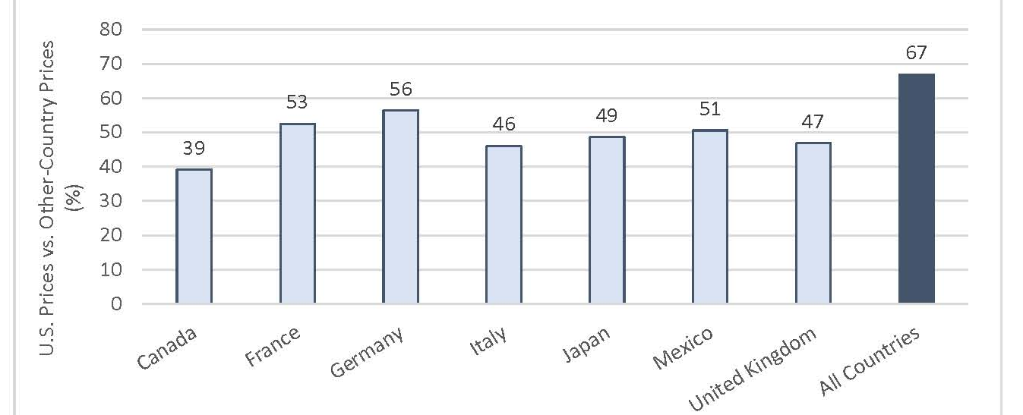
Comparing Generic Drug Prices (2022)
U.S. Unbranded Generic Drug Prices as a Percentage of Prices in selected other (OECD) countries
Source: International Prescription Drug Price Comparisons, A.W. Mulcahy, D. Schwam, and S.L. Lovejoy, RAND, 2024
Notes:
All countries refers to the 33 OECD countries

Slide 92
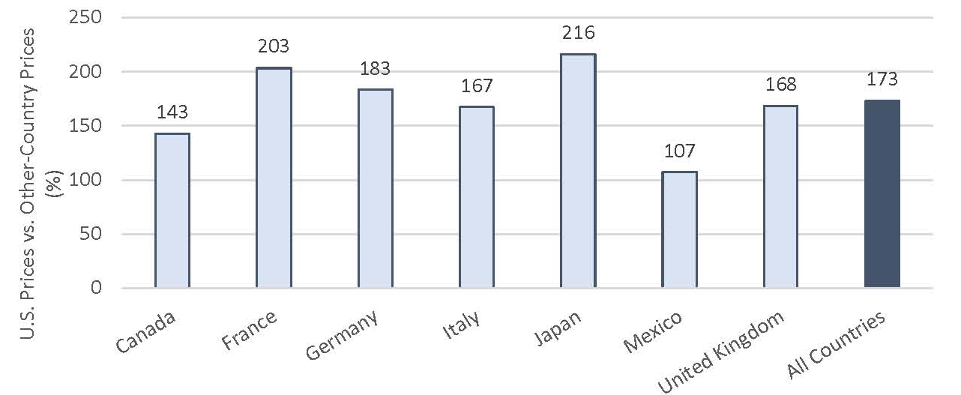
Comparing Drug Prices (2022)
U.S. Prescription Drug Prices as a Percentage of Prices in selected other (OECD) countries when including U.S. price adjustments
Source: International Prescription Drug Price Comparisons, A.W. Mulcahy, D. Schwam, and S.L. Lovejoy, RAND, 2024
Notes:
All countries refers to the 33 OECD countries

Slide 93
In 2022, only 24% of global volume of prescription drugs was sold in the U.S., but U.S. sales accounted for 62% of sales dollars
Source: International Prescription Drug Price Comparisons, A.W. Mulcahy, D. Schwam, and S.L. Lovejoy, RAND, 2024
Notes:
Source: www.rand.org/pubs/research_reports/RRA778-3.html

Slide 94
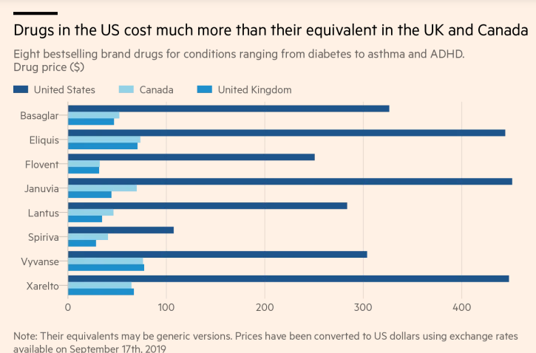
Insulin
Blood
Thinner
Diabetes
Blood
Thinner

Slide 95
Reasons for higher drug prices
By law, Medicare Part D was unable to negotiate drug prices like other insurance programs do. The Inflation Reduction Act of 2022 began to change this, starting 1/1/2026
In 2023, Medicare spent nearly $36 billion on 10 diabetes drugs.
  Researchers found that if Medicare were allowed to negotiate drug prices like the U.S. Department of Veterans Affairs (VA) can, Medicare could save about $4.4 billion/year just on insulin.
Growing concentration of pharmaceutical companies.

Slide 96
Reducing Medicare Drug Spending
Under the Inflation Reduction Act (2022), Medicare began negotiating drug prices with manufacturers
  Beginning January 1, 2026, negotiated prices for 10 drugs were implemented. Estimated savings of:
    $6 bill/year for Medicare; and,
    $1.5 billion/year in out-of-pocket savings for participants.
  Starting 1/1/27, another 15 drugs will see negotiated prices. Then another 15 in 2028 and 20 more drugs per year after that.
The One Bill Beautiful Bill (2025) included provisions that limit which drugs can be considered for future price negotiations
Notes:
The first round of negotiations actually took place in 2023 for 10 drugs with high Part D spending and few generic alternatives.
The first 10 drugs are Eliquis, Jardiance, Xarelto, Januvia, Farxiga, Entresto, Enbrel, Imbruvica, Stelara, and Fiasp/Novolog
Note: The OBBB restricted Medicare from negotiating on several anti-cancer drugs and selected orphan drugs

Slide 97
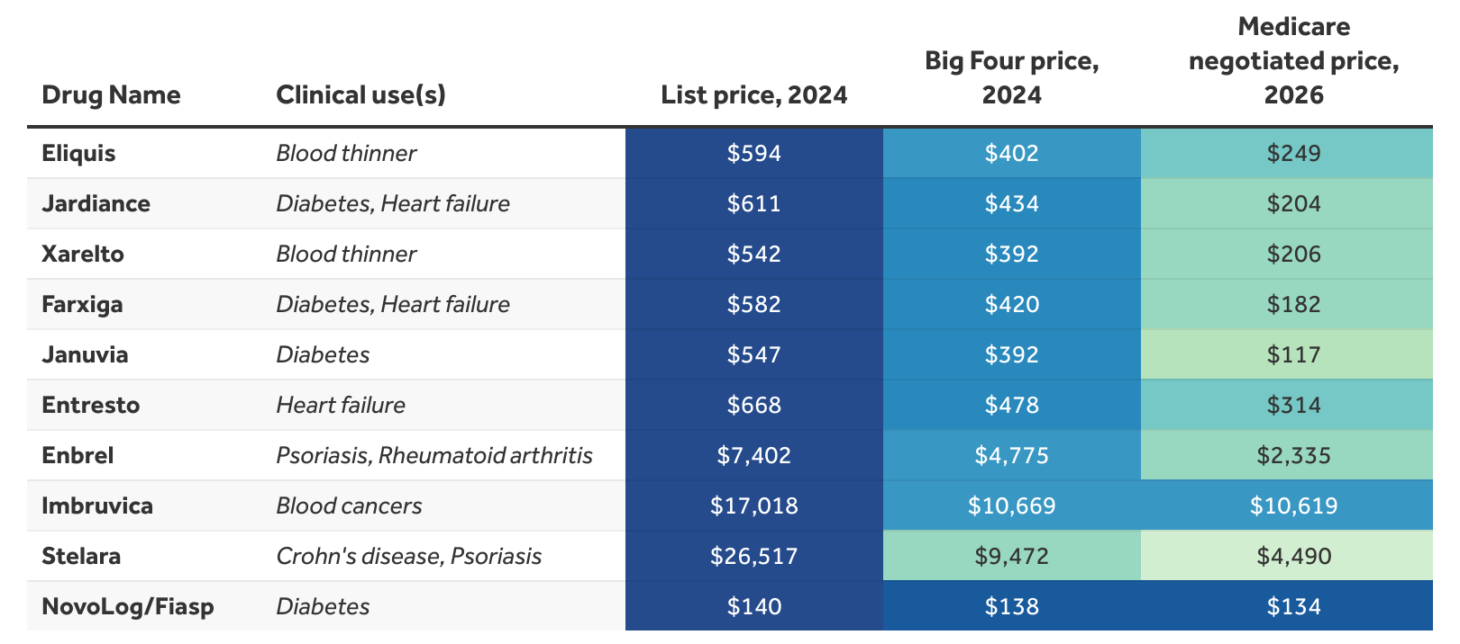
Medicare Price Negotiations
Source: KFF analysis of VA National Acquisition Center, Centers for Medicare and Medicaid Services (CMS), and the Texas Prescription Drug Price Disclosure Program
Notes:
https://www.healthsystemtracker.org/brief/how-medicare-negotiated-drug-prices-compare-to-other-countries/#Comparison%20of%20list%20prices,%20Big%20Four%20prices,%20and%20Medicare%20negotiated%20drug%20prices%20per%2030-day%20supply,%20U.S.%20dollars,%202024

Slide 98
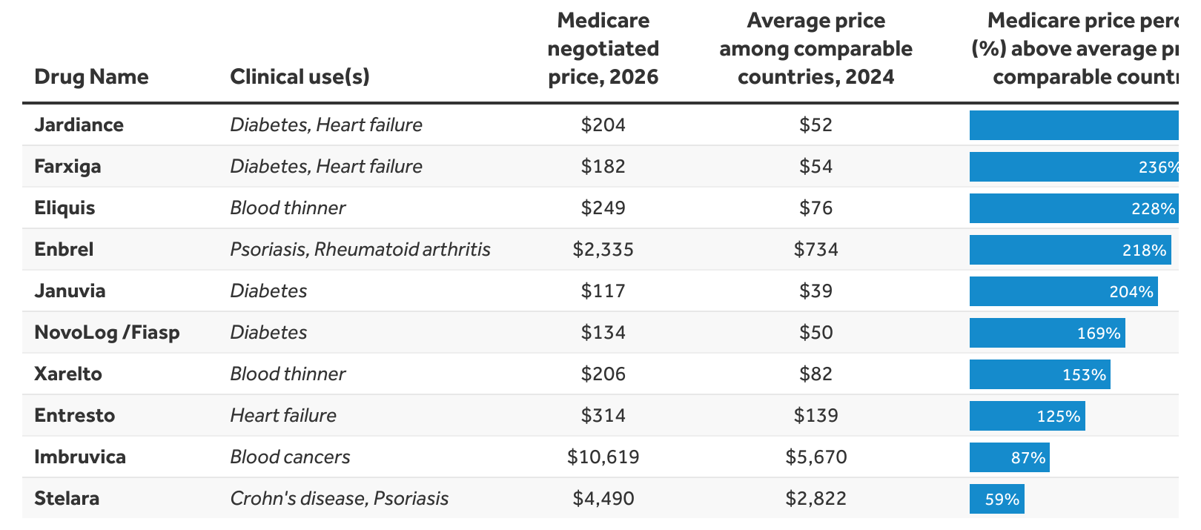
Medicare Price Negotiations
289%
Source: KFF analysis of VA National Acquisition Center, Centers for Medicare and Medicaid Services (CMS), and the Texas Prescription Drug Price Disclosure Program and KFF analysis of national drug formularies and pharmacy webpages
Notes:
https://www.healthsystemtracker.org/brief/how-medicare-negotiated-drug-prices-compare-to-other-countries/#Comparison%20of%20list%20prices,%20Big%20Four%20prices,%20and%20Medicare%20negotiated%20drug%20prices%20per%2030-day%20supply,%20U.S.%20dollars,%202024

Slide 99
How Much is Negotiation Worth?
The CBO estimated that drug pricing negotiation could reduce federal spending by $456 billion and increase revenues by $45 billion over 10 years. This would include:
  direct savings for Medicare Part D ($448B over 10 years)
  lower spending for the Affordable Care Act’s subsidies for commercial health plans
  lower spending for the Federal Employees Health Benefits Program
  more government tax revenue because employers using savings from reduced premiums to fund wage increases for their workers.
Source: Congressional Budget Office, https://www.cbo.gov/system/files/2019-12/hr3_complete.pdf

Slide 100
Concentration in Pharmaceutical Companies
Between 1995 and 2015, 60 drug companies merged into 10.
The number of mergers and acquisitions involving one of the top 25 firms more than doubled, from 29 in 2006 to 61 in 2015
Research indicates that fewer competitors are associated with higher prices -- Especially in the market for generics.
Mergers have a varied impact on innovation: R&D spending, patent approvals, and drug approvals.
  Some studies have found a negative effect.

Slide 101
Concentration in specific markets: 2) Hospital Consolidations

Slide 102
Hospital Consolidation
Reductions in competition in health systems, hospitals, medical groups, and health insurers has surged in recent years.
Between July 2016 and January 2018:
  Hospitals acquired 8,000 more medical practices.
  14,000 more physicians left independent practice to become hospital employees.
Between 1999 and 2018, hospital profit margins soared!
  From 100% in 1999 to 317% in 2018.
Evidence suggests that with more government oversight and restraining mergers, health care costs would have been lower.

Slide 103
Potential Benefits of Consolidation
Consolidation could lead to potential benefits
  Better coordination of care; Investment in care quality; reduction of costly, unnecessary duplication; Savings from scale, etc.
But, …
  Consolidation isn’t integration.
  Evidence doesn’t support the claims.
    Consolidation has not led to lower costs, better quality, or coordinated care.
Source: Martin Gaynor, NIHCM.org, Supersized: The Rise of Hospital Giants

Slide 104
Effects of Hospital Consolidations
Consolidation could lead to potential benefits
  Better coordination of care; Investment in care quality; reduction of costly, unnecessary duplication; Savings from scale, etc.
But Consolidation isn’t integration, and
Evidence doesn’t support the claims; a review of studies of hospital consolidations reveals that:
  13 of 14 price studies find that prices rose after consolidation
  13 of 16 cost studies find that costs rose after consolidation
  20 of 26 quality studies find that quality of care fell or remained the same after consolidation
Source: A Systemic Review of Integration Strategies across the U.S. Healthcare System: Assessment of Price, Cost, and Quality of Care
By Satiani, Bhagwan, David P. Way, David B. Hoyt, and Christopher E. Ellison, Journal of the American College of Surgeons, May 2025
Notes:
Only the abstract of the above-cited article was available at the time of this revision.

Slide 105
Effects of Hospital Consolidations
Cost savings depend on whether the entity taken over is a small, independent organization (potential for sizeable savings) or an organization that is already part of a system (then no discernable cost savings)
Source: The Corporatization of Independent Hospitals, by Andreyeve et al., Journal of Political Economy Microeconomics (2024)
Notes:
Only the abstract of the above-cited article was available at the time of this revision.

Slide 106
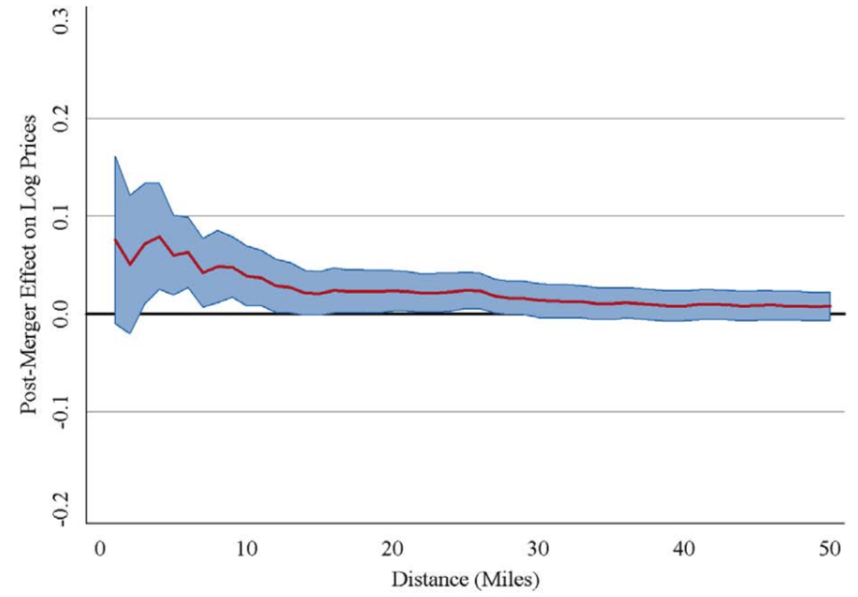
Evidence on Consolidation
Price Increase Following a Hospital Merger
Increase of
About 6%
Very small increase
The price effect of a merger declines with
the distance between the hospitals.

Slide 107
Hospital Monopolization Across the Nation
Hospitals Charge Patients More Than Four Times the Cost of Care
The most expensive hospitals cost of care range from 1,129% at the low end to 1,808% at the high end.
Most of the top 100 most expensive hospitals are located in states in the south and west.
  Florida had the highest number, with 40 hospitals.
  Other top states included Texas with 14 hospitals, Alabama with eight, Nevada with seven, and California with six.

Slide 108
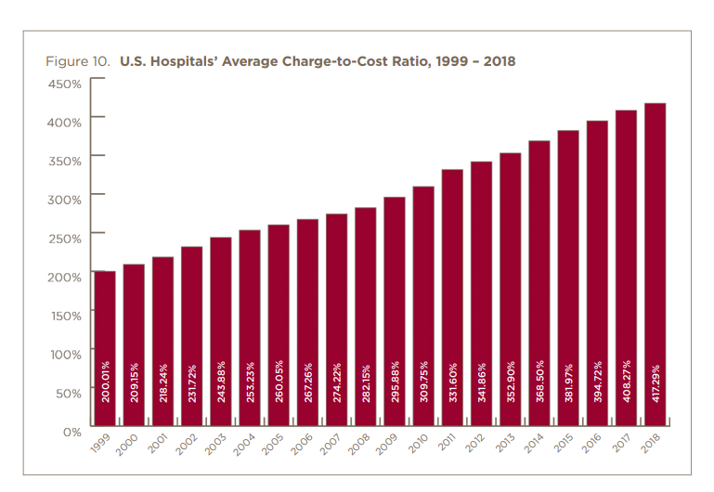

Slide 109
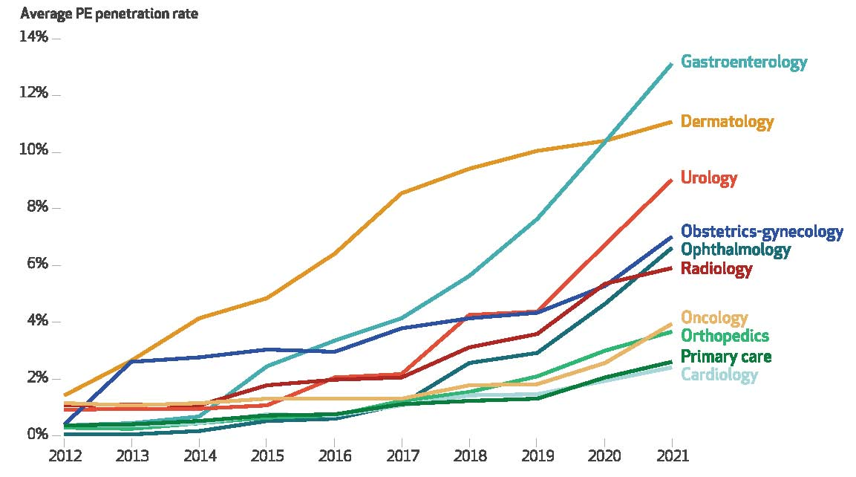
PE Penetration Rate by Physician Specialty
Source: Private Equity-Acquired Physician Practices and Market Penetration Increased Substantially, 2012-2021, by Abdelhadi, Ola, et al., Health Affairs (2024)

Slide 110
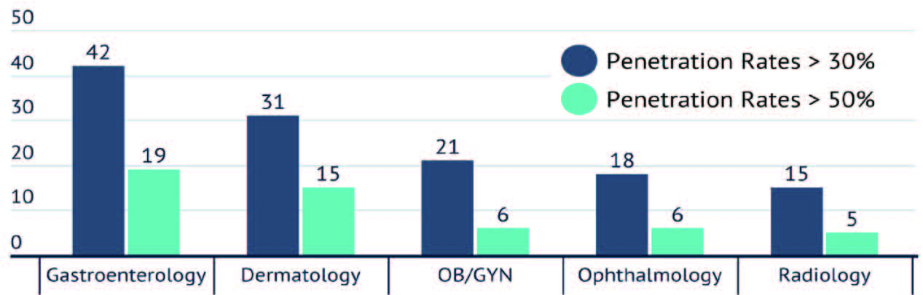
Private Equity Penetration in selected markets
Number of MSAs with Private Equity Market share >50% and >30% in 5 most-concentrated physician specialties (2021) (out of 120 MSAs)
Source: Private Equity-Acquired Physician Practices and Market Penetration Increased Substantially, 2012-2021, by Abdelhadi, Ola, et al., Health Affairs (2024)

Slide 111
Concentration in specific markets:
3) Health Insurance

Slide 112
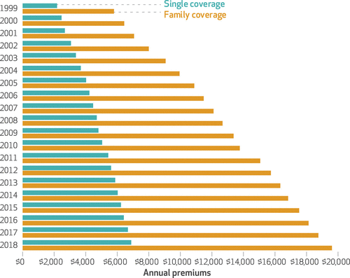
Average Annual Insurance Premiums, 1999-2018
Employer provided, Not Adjusted for Inflation
Single: ~$2,000 to ~$7,000
Family: ~$5,900 to ~$19,500
 | Average Annual Rate of Change
Inflation | 2.19
Health Care CPI | 3.68
Single coverage | 6.51
Family coverage | 6.52
Source: The Commonwealth Fund

Slide 113
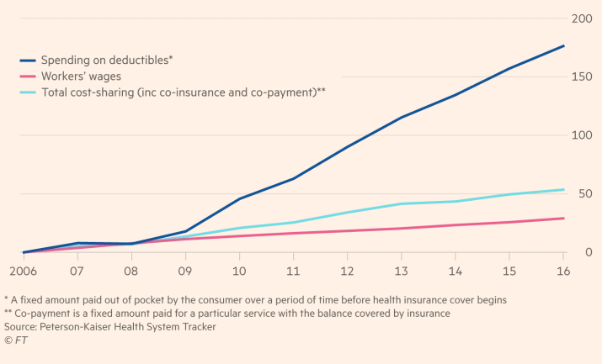
Spending on Deductibles

Slide 114
Reason for Higher Health Insurance Rates
Rising prices in the health sector
Advances in medical technologies
Increased demand for services
Decreasing competition in health insurance markets

Slide 115
Consolidation in Health Insurance Markets
As of 2011, there were close to 100 insurers in Switzerland competing for consumer health care dollars, forcing firms to compete by setting prices to just cover costs.
In the United States, markets are state specific; consumers can choose only from plans available in the state in which they reside.
In 2019, of the 50 states and the District of Columbia:
  21 had only 1 or 2 insurers (up from 11 in 2014)
  14 had 3 or 4, and
  16 states had 5 or more. (CA had 11)
Source: KRR, Number of Issuers Participating in the Individual Health Insurance Marketplaces
Notes:
https://www.kff.org/other/state-indicator/number-of-issuers-participating-in-the-individual-health-insurance-marketplace/?currentTimeframe=0&sortModel=%7B%22colId%22:%22Number%20of%20Issuers%20in%202019%22,%22sort%22:%22desc%22%7D
6 Roy, Avik. “Why Switzerland Has the World’s Best Health Care System.” Forbes, April 29, 2011; https://www.forbes.com/sites/theapothecary/2011/04/29/why-switzerland-has-the-worlds-best-health-care-system/#2416d9a67d74.
7 Henry J. Kaiser Family Foundation. “Number of Issuers Participating in the Individual Health Insurance Marketplaces.” State Health Facts; https://www.kff.org/other/state-indicator/number-of-issuers-participating-in-the-individual-health-insurance-marketplace, accessed July 2019.

Slide 116
What the Affordable Care Act did:
Created Insurance “exchanges” where individuals could buy insurance
  Premium could be subsidized by federal government (depends on person’s income)
  Subsidies expanded during the pandemic
Significantly expanded Medicaid eligibility, now up to 138% of poverty level
  Fed pays 90% of the cost for these people
  Many Red (21) and Blue (20) states have accepted this expansion
  Added about 20 million people to Medicaid
Required insurance companies to cover children up to age 26
Required people to have insurance and companies to offer insurance to employees (many exceptions allowed)
Prevented insurance companies from excluding preexisting conditions
Notes:
Also tried to develop a national electronic records system and piloted a few cost-effectiveness studies

Slide 117
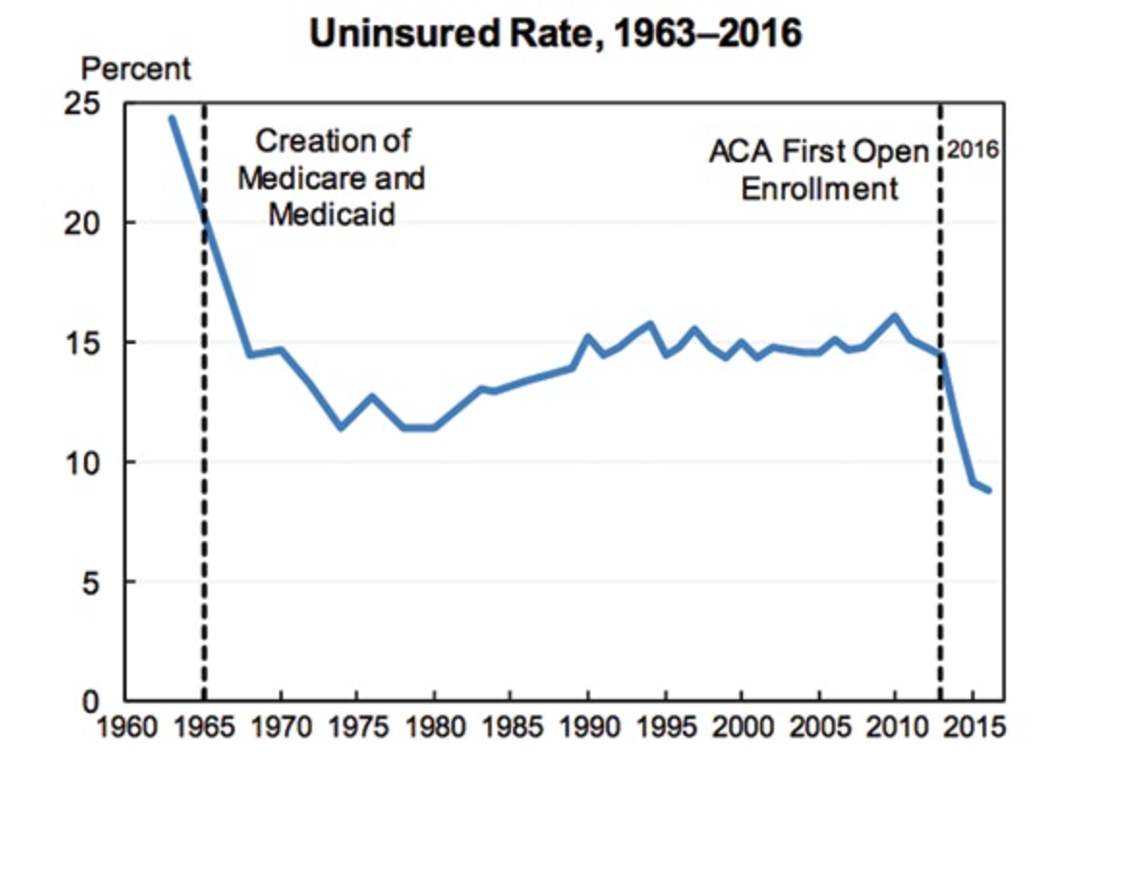
Uninsured rate dropped dramatically after first ACA open enrollment in 2016
Source: The Century Foundation
Notes:
The Affordable Care Act, formally called the Patient Protection and Affordable Care Act, was signed in 2010 by President Obama, but the major provisions weren’t put into place til 2014 and the first open enrollment period wasn’t until 2016. The enrollment period is basically a window of time where you can sign up for a plan/benefits, and if you miss the window you could lose your benefits or have to pay a fine, and you usually can’t enroll until the next period.
I know overall the ACA was talked about a fair amount in the readings on Moodle so we specifically want to focus just on the healthcare exchanges it introduced and the impacts on enrollment. In the graph here, you can see how after the creation of Medicare and Medicaid, the uninsured rate dropped substantially, but after the ACA’s first open enrollment, it dropped by the same amount if not more and this is important because it shows the extent of the impact of the ACA.

Slide 118
What the One Big Beautiful Bill did:
Imposed additional requirements for Medicaid-expansion people:
Tougher work requirements (many participants already working)
Additional eligibility verifications (2x per year); may be difficult for many recipients to follow
Multiple groups estimate about 10 million people will lose Medicaid eligibility and hundreds of rural hospitals will have to close
Savings of around $1 trillion expected over next 10 years
Notes:
OBBB tax cuts are expected to reduce federal revenues by $4.5-5 trillion over next 10 years

Slide 119
Fact vs Fiction
Illegal immigrants are not eligible for Medicare or Medicaid
  Exception: States can offer emergency care to illegal immigrants; this comprises less than 0.5% of all Medicaid spending

Slide 120
Alternative Health Care Structures

Slide 121
Definition: Universal Coverage
Universal coverage – refers to a healthcare system in which all individuals have the same insurance coverage.
Generally, this coverage includes:
  Access to all needed services and benefits.
  Protects individuals from excessive financial hardships.
    Medical indebtedness is the #1 cause of bankruptcies in the United States.
Notes:
https://ajph.aphapublications.org/doi/abs/10.2105/AJPH.2018.304901?journalCode=ajph

Slide 122
Definition: Single-Payer
Single-payer - refers to financing a healthcare system by making one entity solely and exclusively responsible for paying for medical goods and services. (Not necessarily the government.)
Only the financing component is nationalized.
  The money for the payment can be either collected by:
    Taxes collected by the government
    Premiums collected by National or Public Health Insurance
Single-payer systems: 17 countries
  Norway, Japan, United Kingdom, Kuwait, Sweden, Bahrain, Brunei, Canada, United Arab Emirates, Denmark, Finland, Slovenia, Italy, Portugal, Cyprus, Spain, and Iceland.

Slide 123
Definition: Socialized Medicine
Socialized medicine – this model takes the single-payer system one step further.
  Government not only pays for health care but also operates the hospitals and employs the medical staff.
This is NOT, and has NEVER been, part of the debate in the United States.

Slide 124
Potential pros and cons of national insurance
Potential Pros
  Universal coverage
  Government controls quality of care
  No medical bills or co-pays (or debt!)
  Consolidated medical records (lower administrative costs; fewer errors)
  Higher wages/wage growth
Potential Cons
  Higher taxes
  Long wait times for elective services
  Government determines service eligibility
  May reduce incentives for innovation

Slide 125
Consequences of Rising Health Expenditures
Reduced access to care
  Waiting for treatment increases costs
Slower wage growth
Personal bankruptcies
Impact on government budgets
LO2
21-125
Notes:
Rising health care costs cause employers to reduce, or eliminate, offering health insurance. The wages grow at a slower pace because health care costs make up a larger percentage of pay. Employers save money on health care if workers are part-time or temporary. Spending through Medicare and Medicaid is the fastest growing segment of the federal budget, and states can’t cover their share.

Slide 126
Summary/closing thoughts
Healthcare is a very complex issue
The U.S. HealthCare system is not performing well.
  Very expensive with mixed results regarding quality and coverage.
Third-party payment system is inefficient
  Separates buyers and sellers from the price
  For other goods, prices signal resource shortages or surpluses
  High administrative costs
One reason for rising expenditures is reduced competition in healthcare markets.

Slide 127
Closing Thoughts…
Is health care a right or a privilege?
  If the former, this argues for greater government involvement
Someone must decide how to ration healthcare services. Currently, health insurance companies do this
The United States has the only profit-motivated healthcare system in the world; changing the focus from maximizing profits to maximizing health would help.

Slide 128
Resources for further exploration
The Kaiser Family Foundation (www.kff.org) is a great source for health care data
For international comparisons: Health at a Glance 2025, OECD
Centers for Medicare and Medicaid Services (cms.gov)
For info on hospital and physician consolidations (including the rise of venture capital) see the National Institute for Health Care Management at NIHCM.org

Slide 129
Thank you!
Any Questions?
www.NEEDEcon.org
Robert Rebelein, Ph.D.
Rebelein@vassar.edu
Contact NEED: info@NEEDEcon.org
Submit a testimonial: www.NEEDEcon.org/testimonials.php
Become a Friend of NEED: www.NEEDEcon.org/friend.php

